Slide 1
How to talk about controversial subjects without making enemies of your friends
SPU Day of Common Learning 2012
Zhiguo Ye, History Department
Laura Sweat, School of Theology
Mikyung Kim, Sociology Department
Ruth Ediger, Poli Sci & Geography Department

Slide 2
Overview
Preliminaries, Introductions
Controversial and Taboo Subjects
Some quick guidelines for having a sane conversation on controversial subjects
Conclusions

Slide 3
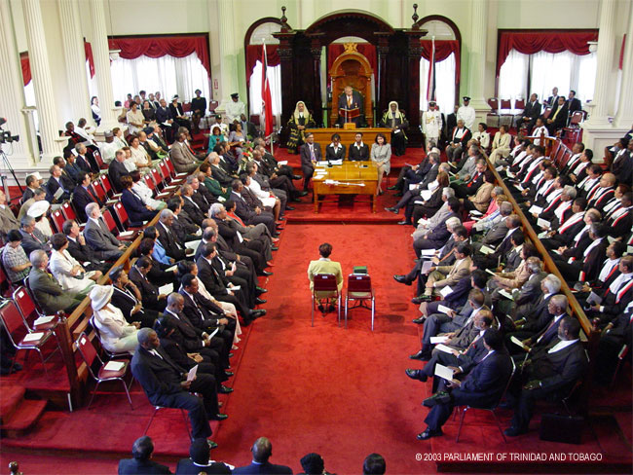

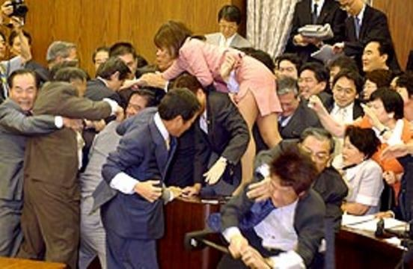
Orderly institutions aren’t always so orderly
library2.nalis.gov.tt
green.autoblog.com
zombiegamer.co.za

Slide 4

What is the most controversial conversation you have had in the last couple of years? What was the subject?
First, let’s start with the most controversial issues in our society.
Get into groups to discuss: What are some of today’s “hot button” issues?
http://butchbellah.com/home/2012/07/18/whats-your-hot-button/
Describe a recent conversation where the discussion ended in an argument. What was the subject?

Slide 5
Share the subject of the very controversial conversation with the group

Slide 6
Some Of the Many Contentious Issues
Political Controversies
-Should someone who is here in the US illegally be allowed to get federal aid for college?
-Should marriage be legal for all couples no matter what their sexual orientation?
Religious Controversies
-Is Scripture authoritative for our lives and in what way?
-Are individuals responsible for societal sins?
Sociological Controversies
-Do you think our society is color blind?
-Is someone of a different race threatening to you?
Historical Controversies
For example who should apologize for World War II atrocities? Germany for the holocaust? Japan for their brutal occupation? US for the atomic bombings and firebombing of civilians?

Slide 7
Some guidelines or ground rules for sanely talking about very controversial subjects
Use “I” statements
  Encourages conversation: “I feel…”, “I think…”, “In my opinion…”, “My experience is…”
  Shuts down conversation: “I think that you…”, “Everybody knows that…”, “All right thinking people…”
No interrupting
Confidentiality and Grace
  We need to be able to say things that are hard to say
  Need to be able to ask difficult questions and perhaps even word things in an unintentionally hurtful way
  It’s ok to say “I am hurt by what you said because I hear it this way…”
Assume that all participants are reasonable people..
  with valid points of view even if those views are diametrically opposed to your views
Be present in mind, body, and spirit
  Side comments can be easily misinterpreted
  Be mindful of what you feel and how you think
  Be mindful how you speak to others and the manner that you do it

Slide 8
An Illustration from the “real world”
http://www.thedailyshow.com/watch/mon-october-17-2011/indecision-2012--hardcore-sects-edition---mormonism

Slide 9
Some guidelines or ground rules for sanely talking about very controversial subjects
Use “I” statements
  Encourages conversation: “I feel…”, “I think…”, “In my opinion…”, “My experience is…”
  Shuts down conversation: “I think that you…”, “Everybody knows that…”, “All right thinking people…”
No interrupting
Confidentiality and Grace
  We need to be able to say things that are hard to say
  Need to be able to ask difficult questions and perhaps even word things in an unintentionally hurtful way
  It’s ok to say “I am hurt by what you said because I hear it this way…”
Assume that all participants are reasonable people..
  with valid points of view even if those views are diametrically opposed to your views
Be present in mind, body, and spirit
  Side comments can be easily misinterpreted
  Be mindful of what you feel and how you think
  Be mindful how you speak to others and the manner that you do it

Slide 10

Now practice using the guidelines
Option 1: Get into groups of 2-4, choose a controversial topic (one we discussed here or choose your own), and practice talking about it using the guidelines presented. What happened when you did this?
Option 2: Get into groups of 2-4, choose a non-controversial, and practice talking about it violating all the guidelines provided. What happened when you did this?
Potential non-controversial topics:
-Godzilla vs. T-Rex: who is more dangerous?
-Fruit vs. Vegetables: which is better for you?
-Grass vs. Astroturf
-The Atlantic Ocean vs. the Pacific Ocean
-etc.

Slide 11

Now Switch!

Slide 12
So, what happened?
Option 1: When you followed the guidelines with the controversial subject how did this affect the conversation? How did you feel about the subject and the people you were talking to?
Option 2: When you violated the guidelines with the non-controversial subject how did this affect the conversation? How did you feel about the subject and the other people?

