Slide 1
Moral Thinking, Fast and Slow
Margaret A. Brown
Department of Psychology
Jared D. Wymer
Department of Industrial-Organizational Psychology

Slide 2
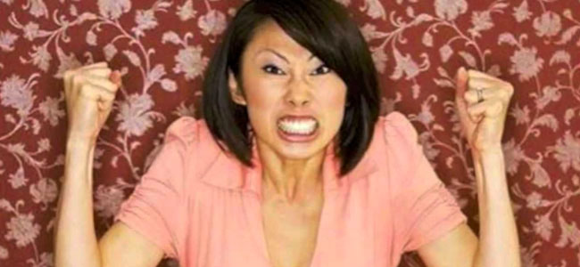

Slide 3
17 x 24 =

Slide 4
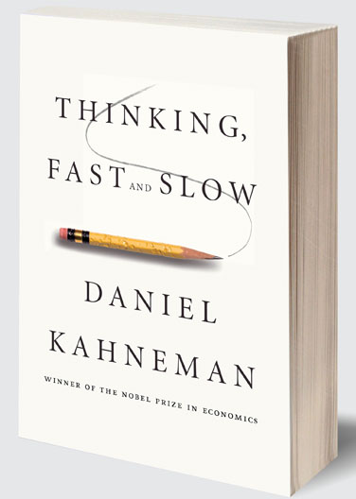
Thinking, Fast and Slow, Kahneman (2010)
System 1
System 2
Fast
Non-conscious
Automatic
Associative
Slow
Conscious
Controlled
Rule-based

Slide 5
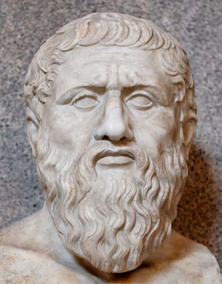
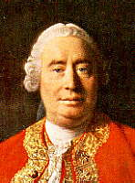
Moral Thinking, Fast and Slow (an historical perspective)
Moral rationalism: Plato, Kant; Moral truths are knowable by reason alone.
Moral sentimentalism: Hume; "Reason is and ought only to be the slave of the passions [emotions].”

Slide 6
Scenario #1: A woman was near death from a rare kind of cancer. There was one drug that the doctors thought might save her. It was a form of radium for which a druggist was charging ten times what the drug cost him to make. The sick woman's husband, Heinz, went to everyone he knew to borrow the money, but he could only get together about half of what it cost. He told the druggist that his wife was dying, and asked him to sell it cheaper or let him pay later. But the druggist refused. So, Heinz got desperate and stole the drug. Was there anything wrong with what he did? Please indicate yes or no, and your reasons.
Kohlberg, 1958

Slide 7
Kohlberg’s (1981) Stages of Moral Reasoning
Stage | Name | Example
1 | Obedience | Heinz should not steal the medicine because he would be put in prison, which would mean he is a bad person.
2 | Self-Interest | Heinz should steal the medicine because he will be much happier if he saves his wife, even if he will have to serve a prison sentence.
3 | Conformity | Heinz should steal the medicine because his wife expects it; he wants to be a good husband.
4 | Law-and-Order | Heinz should not steal the medicine because the law prohibits stealing, making it illegal.
5 | Human Rights | Heinz should steal the medicine because everyone has a right to choose life.
6 | Universal Human Ethics | Heinz should steal the medicine, because saving a human life is a more fundamental value than the property rights of another person.

Slide 8
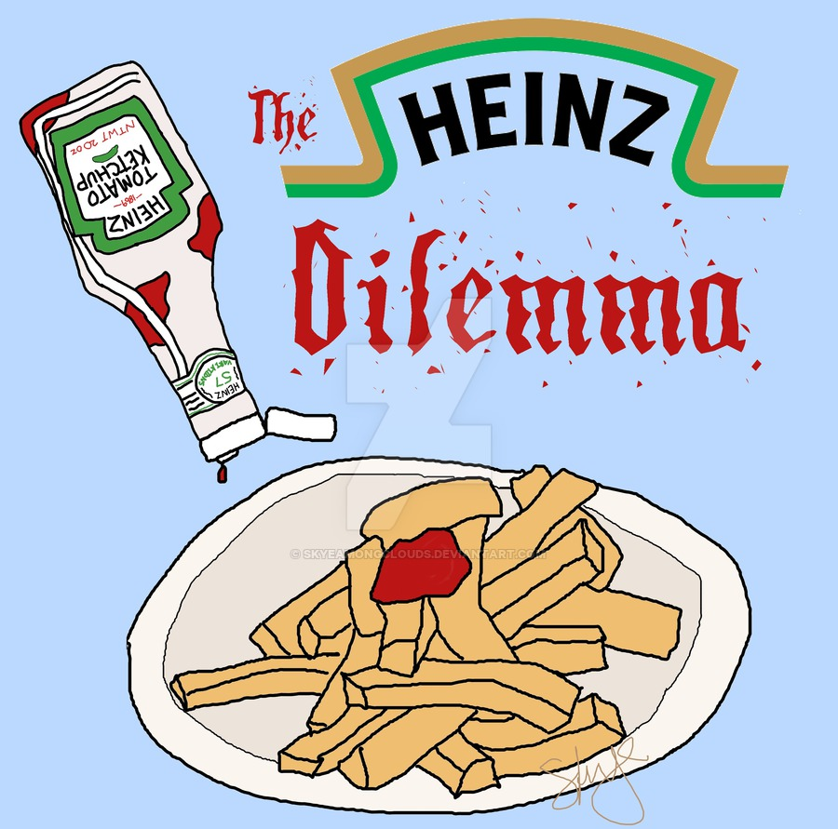
Criticism of Kohlberg
Kohlberg emphasizes rational, deliberate thinking (System 2) in moral judgments, but not all moral judgments are strictly rational.

Slide 9
Scenario #2: Susan is cleaning out her closet, and she finds her old American flag. She doesn't want the flag anymore, so she cuts it up into pieces and uses the rags to clean her bathroom. Was there anything wrong with what she did? Please indicate yes or no, and your reasons.
Haidt, Koller, & Dias, 1993

Slide 10
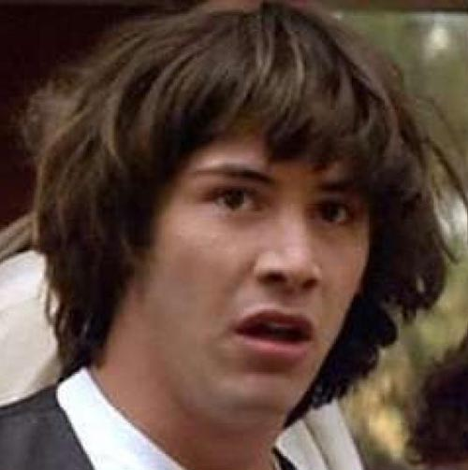
Moral Dumbfounding (Haidt, 2001)
The second scenario may FEEL wrong, but it is often difficult for people to articulate reasons why it is wrong without simply restating the problem (e.g., that’s unpatriotic).
38% of people generate reasons manufacturing harm, e.g. “Maybe the woman will feel guilty afterward about throwing out her flag?” or “The rags might clog up the toilet and cause it to overflow.”

Slide 11
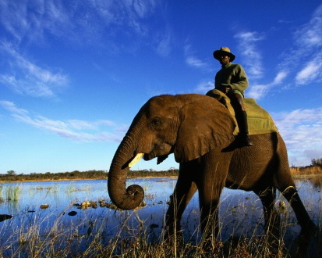
Social Intuitionism (Haidt, 2012)
Moral judgments and actions are influenced more by intuition than by reason.
Intuitions (System 1) are first, then we search for post-hoc rationalizations (System 2).

Slide 12
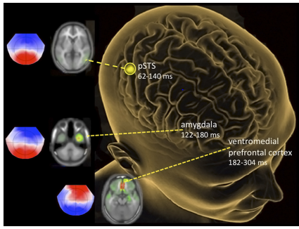
The Intuitive Moral Brain (Decety & Wheatley, 2015)
Notes:
Posterior superior temporal sulcus [pSTS], amygdala, ventromedial prefrontal cortex (vmPFC)
Affective processing occurs in the very early stages of moral cognition processing (i.e., 122–180 ms after stimulus onset over the amygdala/temporal pole and 182 ms in the vmPFC)

Slide 13
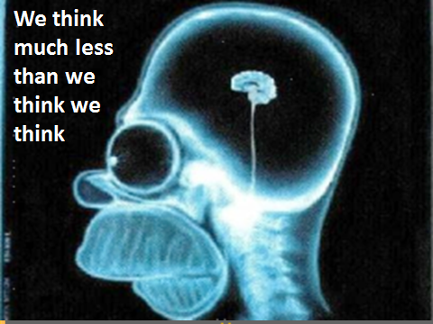

Slide 14
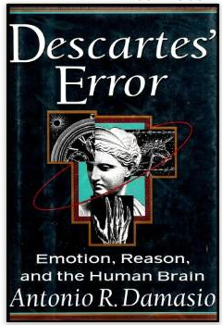
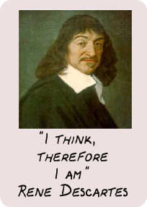
But it’s not as bad as it sounds…

Slide 15
The Five Moral Foundations What is the source of our moral intuitions?
Care/Harm
Fairness/Justice
Ingroup Loyalty
Authority
Sanctity/Purity

Slide 16
http://www.moralfoundations.org/
 | Care/ Harm | Fairness/ Justice | Ingroup Loyalty | Authority | Sanctity/ Purity
Adaptive Challenge | Protect and care for children | Reap benefits of two-way partnerships | Form cohesive coalitions | Forge beneficial relationships in hierarchies | Avoid contamin-ants
Original Triggers | Suffering, distress, neediness of one’s child | Cheating, cooperation, deception | Threat or challenge to group | Signs of dominance and submission | Waste products, diseased people
Current Triggers | Baby seals, refugees | Marital fidelity, broken vending machines | Sports teams, nations | Bosses, respected professionals | Taboo ideas, genetically modified food
Emotions | Compassion | Anger, guilt, gratitude | Group pride | Respect, fear | Disgust
Virtues | Kindness | Trustworthi-ness | Patriotism, self-sacrifice | Obedience, deference | Temperance piety

Slide 17
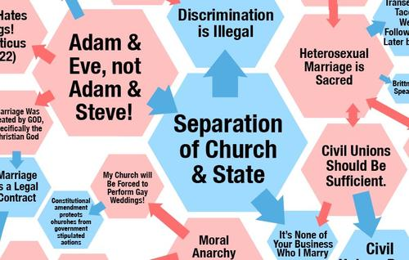
Example: Gay marriage

Slide 18
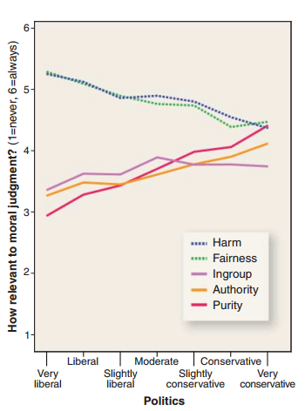
Haidt (2007) Science

Slide 19
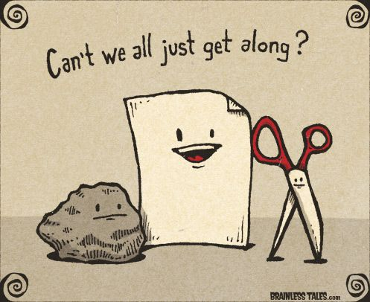
Well, can’t we? Should we?

