Slide 1
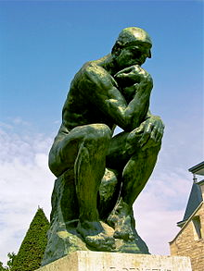
Free Will: What Is It & Have We Got It?
What is free will?
The power to do otherwise than one in fact does.
Is free will compatible with determinism?

Slide 2
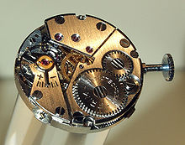
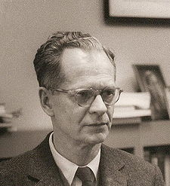
Determinism
Determinism: given the past, only one future is possible.
I might think that multiple futures are open me, but that’s an illusion, if determinism is true.
Physical determinism: a complete statement of the laws of nature together with a complete description of the condition of the whole universe at any given time LOGICALLY IMPLIES a complete description of the condition of the whole universe at any later point in time.
B. F. Skinner →

Slide 3
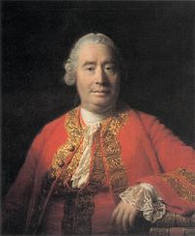
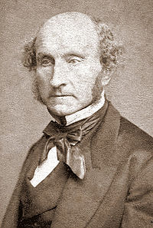
Compatibilism
Compatibilism: the view that we can have free will even if all of our actions are fully determined.
David Hume →
What exactly is a free act?
Compatibilists hold that you perform an act freely if you do it because you want to (or intend to)—even if what you want (or intend) is itself determined.
J. S. Mill →
In what sense can one “do otherwise” if compatibilism is true?
Just in the sense that one would have done otherwise if one had wanted to (or intended to).

Slide 4
Incompatibilism
Incompatbilism: the view that free will is not compatible with determinism: if determinism is true, then we never act freely; and if we ever act freely, then determinism is false.
Peter van Inwagen →
Incompatibilists typically claim that if you perform an act A freely at time T, then at T you have the power to do A but also the power to refrain from doing A.

Slide 5
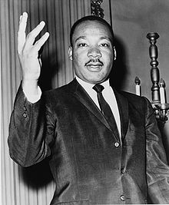
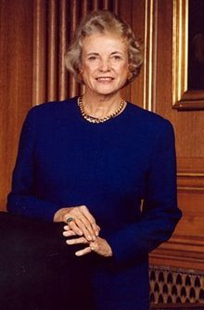
Does it matter? (Four things to consider)
Moral Responsibility?
If my actions ultimately depend entirely on factors I do not control (such as past states of the world and laws of nature), can I reasonably be held morally responsible for what I do?
Should I be blamed for wrongdoing if no alternative was within my power?

Slide 6
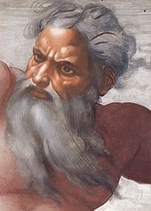
2. Divine Goodness?
God is the Creator.
So, if my acts are determined, then the determining factors (e.g., initial state of the world plus laws of nature) are set in place by God.
So, if determinism holds, God determines my acts (directly or indirectly), including my sins.
But then isn’t God the author of evil?
Also, God holds people accountable for their sins.
So, if determinism holds, then God determines our sinful acts & yet blames us for them.
Would that be just?

Slide 7
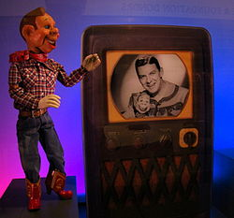
3. The Meaning of Life?
In the Christian story, God freely & generously offers love to human beings.
The story is meaningful if we respond freely.
But if we don’t respond freely, then aren’t we are like robots or puppets?
Some of us respond positively to God’s love; others don’t—but in each case the response is caused by God.
Where is the meaning in such a scheme?

Slide 8
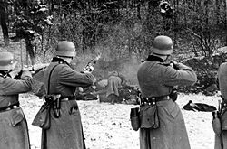
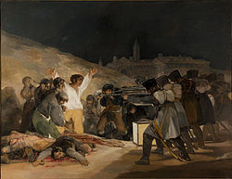
4. The Problem of Evil?
Most Christians appeal to free will in trying to explain why God allows evil.
This appeal to free will works only if humans have free will in the incompatibilist sense.
Suppose we are free only in the compatibilist sense.
Then God could give us (compatibilist) free will but also determine all our actions.
So, God could give us free will while causing us (e.g., through laws of nature) to perform only right acts.

