Slide 1
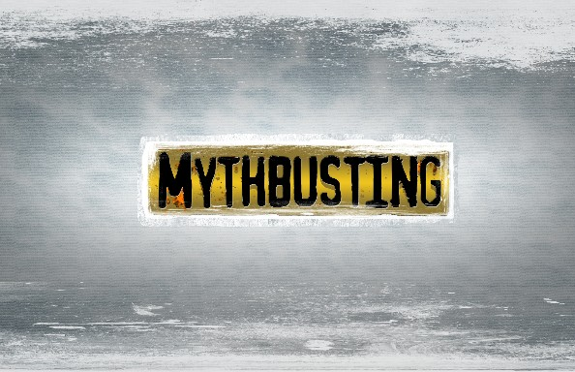
HUMAN TRAFFICKING
Day of Common Learning School of Health Sciences Grace Lane, BSN
Demaray 254 Sandy Mortinson, MSN, RN, CNOR Elena Raney, BSN
October 21st, 2014 Carol McFarland, MN, RN, CNE Nathan Bennett
Suzi Spooner
Notes:
Welcome - Introductions

Slide 2
Representatives of Catholic, Anglican, Jewish, Hindu, Buddhist, Orthodox, and Islamic faiths
U. S. State Department Trafficking in Persons Report 2015
Notes:
In Vatican City on December 2, 2014, faith leaders or their representatives each shared their views and commitment to ending modern slavery based on his or her own religious beliefs.
Carol and I would like to start today by reading by their Declaration of Religious Leaders Against Modern Slavery.

Slide 3
How is Human Trafficking defined and what are the types
of Human Trafficking?
What are the common myths surrounding Human Trafficking?
How/what/where is Human Trafficking happening in our city,
county, state? On our campus?
How is Human Trafficking being addressed on the Federal,
county, state, and community levels?
WHAT CAN WE DO AS INDIVIDUALS TO FIGHT HUMAN
TRAFFICKING?
What is happening on the SPU campus to fight Human Trafficking?
Notes:
Today, we are presenting only a snapshot of this problem.
We are going to start by looking at myths surrounding HT, discuss what the state of HT in our area, some of the things that are being done, and what we can do as individuals to help abolish human trafficking.
Are we unknowingly contributing to the problem? Cell phones? – tantalum – children soldiers.
Finally, we will hear a few things that are happening on our campus.
Our hope is that you will take away at least more awareness and understanding of Human Trafficking and our individual roles in both contributing to and helping reduce instances of HT in our own back yards. AND – prompt you to become individually active in helping to end HT.

Slide 4
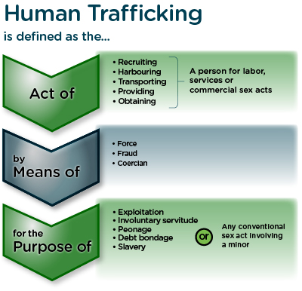
Notes:
You can find definitions of HT in the dictionary, on Wikipedia (of course) and multiple other places on the internet.
This is the US Government’s definition and is also very similar to one from the United Nations.
This is on one side of your paddles and we will be referring to this definition as we go on.

Slide 5
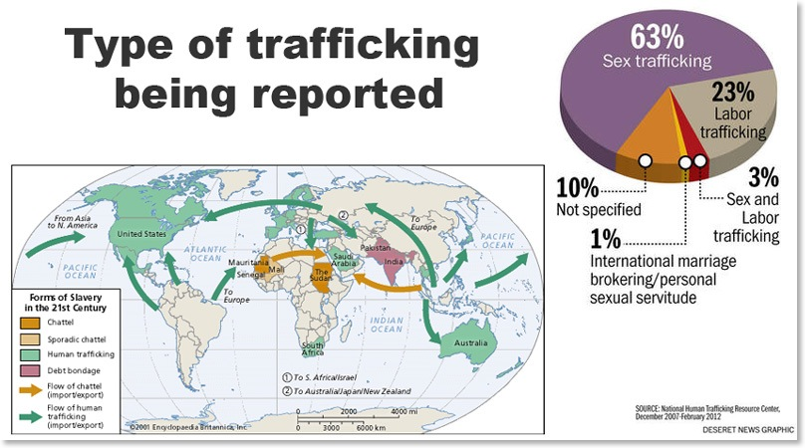
Notes:
The three types of Human Trafficking are labor, commercial sex acts, and trafficking of human organs.
Today we will just be looking at labor and sex trafficking.
Depending on where you look, you will find various numbers for the different types of HT.
This graphic from the National Human Trafficking Resource Center is more representative of the focus of the news we hear – much more about sex trafficking than labor when in fact it is also more common in the US than most people think.
The Farming industry for example – especially fruit and produce – is an especially fertile area for HT. If you have ever been to Central Washington, you may have seen some of the ‘housing’ provided for the migrant workers in the orchards there.
A common misunderstanding is that the workers mostly here illegally, when in fact many have legitimate visas, and one method of trafficking them is to take away their legal documents.
Other areas fertile for trafficking are in the non-regulated industries such as restaurants, domestic services, and even begging on the street. How many of us automatically think that people asking for money at the stop light are doing it of their own free will?

Slide 6
Common Myths about Human Trafficking
Human Trafficking is a crime that must involve some form of travel, transportation, or movement across state of national
borders.
There must be elements of physical restraint, physical force, or physical bondage when identifying a Human Trafficking
Situation.
If the trafficked person consented to be in their initial situation but was informed about the type of ‘work’ they would be doing, it cannot be Human Trafficking or against their will.
Notes:
Much of this information comes from the Polaris Project. Polaris is a nonprofit, non-governmental organization that works to combat and prevent modern-day slavery and human trafficking.
IN HT, although transportation may be involved as a control mechanism to keep victims in unfamiliar places , it is not a required element of the trafficking definition.
HT is more accurately characterized as exploitation, a form of involuntary servitude or ‘compelled service’ where an individual’s will is overpowered through force, fraud, or coercion. Physical restraint, bodily harm, or physical force are also not require elements of HT.
Psychological means of control, such as coercion, threat, fraud, or abuse of the legal process are sufficient elements of the crime. Traffickers have sometimes been call ‘amateur psychologists’ who make victims emotional hostages by taking care of their psychological needs or threatening them or their family members. “Selling the dream” – to young women – clothes, money,
Finally, a victim cannot consent to be in a situation of human trafficking. Initial consent to commercial sex or a labor setting prior to acts of force fraud, or coercion is not relevant to the crime, nor is the payment.

Slide 7
Common Myths about Human Trafficking
Sex trafficking is the only form of Human Trafficking.
Trafficking victims are only immigrants from other countries and here in the country illegally.
Children who are prostitutes are considered criminal.
Only pedophiles have sex with minors.
We know how many people are enslaved today.
Notes:
We know from the definition that there are 3 types of HT. As I mentioned before, sex trafficking gets the most press so it is not difficult to see how many people may think this Is the only type.
Victim’s are not only from other countries – in fact one statistic from California Alameda county DA’s office suggested that 83% of sex trafficking victims in the US were American born.
For children The United Nations has a Trafficking of Persons Protocol, and according to that protocol ,a child ( that is anyone under the age of 18) cannot give a valid consent for a commercial sex act.
Therefore, the child is a victim of exploitation – not a criminal.
Unfortunately, the age of consent and safe harbor laws vary by state in the US so in some states children continue to be arrested for prostitution or sometimes they are arrested in other criminal activity as a byproduct of their
sexual exploitation – for example, drug use/possession, truancy, loitering, petty theft. Tragically, this reinforces that the children are not victimized and they are charged with crimes rather than getting help.
Although rings of pedophiles exist, to think that all those who buy sex from children are affected by this abnormal psychological condition prevents us from see that it is often ’normal’ people in our communities who buy sex from trafficked youth.
We know how many people are enslaved today. Hardly -

Slide 8
So many statistics – so many sources:
In Seattle businesses, 27,000 buyers solicit online sex through 130
different website every day
- a 24-hr. survey counted 8700
online postings and responses
concerning men seeking commercial
sex
In 2012 the International
Labor organization estimated
that 20.9 million people
were enslaved
Notes:
Why Is Human Trafficking so Difficult to Measure?
It takes many different forms.
It occurs largely in hidden populations.
It is difficult to discover, let alone quantify.
Research in human trafficking is further limited by the misuse of terms, poor or inconsistent methodology, and lack of adequate funding. For these reasons, human trafficking statistics, including the estimates here, should be regarded cautiously.
While no measure of human trafficking published today contains statistics from every country in the world, the International Labor Organization is widely considered as having the best estimates.
To learn more about the Seattle statistic, there is an excellent panel discussion on The State of Sex Trafficking in King County – you can listen to it online and the link is in the information on your paddle.
So for this Seattle stat - Along with help from Google, the King County prosecutor’s office analyzed 100 websites. They found that 2 PM was the busiest hour of the day and site users included tech workers, teachers, executives, lawyers, and even pastors.
In one interview a sex worker who worked out of her home said she was on the phone with a customer who was going into great lurid, detail about his expectations would be when they met when he had to pause and in the background she heard someone ask him “When do you need these reports?”
Additionally, when 27 prostitution survivors were surveyed >60% said they had sex with clients on company properties where the men worked.

Slide 9
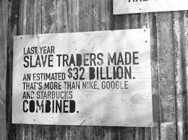
So many statistics – so many sources:
Between 14,500 and 17,500 people are trafficked into the U.S. each year
Human trafficking is the third largest international crime industry
(behind illegal drugs and arms trafficking). It reportedly generates a profit
of $32 billion every year. Of that number, $15.5 billion is made in
industrialized countries.
Notes:
To give a little perspective, HT generates more than Nike, Google, and Starbucks combined.

Slide 10
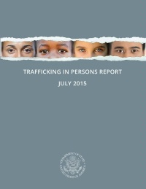
U.S. Department of State
According to the U.S. State Department, 600,000 to 800,000 people are
trafficked across international
borders every year, of which
80% are female and half are
children.
Notes:
The U.S State Department also publishes this report annually and includes country-by-country information on the state of trafficking, prosecutions, recommendations, etc. Countries are assigned a tier level
Tier 1 Countries whose governments fully comply with the US Trafficking Victim’s Protection Act’s minimum standards for the elimination of trafficking.
Tier 2 Countries whose governments do not fully comply with minimum standards but are making significant efforts to bring themselves into compliance with those standards.
Tier 3 Countries whose governments do not fully comply with the TVPA’s minimum standards and are not making significant efforts to do so. The TVPA lists additional factors to determine whether a country should be on Tier 2 (or Tier 2 Watch List
At the end of this report - There are great colored maps for different regions in the world. It is very easy to pull up this pdf online.

Slide 11
NHTRC: National Human Trafficking Resource Center
2014 Data Breakdown for Washington State:
500 Phone calls
12 e-mails
22 on-line tip reports
(13th highest in US and DC)
http://www.traffickingresourcecenter.org/sites/default/files/NHTRC%202014%
20Washington%20State%20Report%20-%20WA%20-%2001.01.14%20-%2012.31.14.pdf
Notes:
This is an excellent, excellent source of information.
The National Human Trafficking Resource Center (NHTRC) is a national anti-trafficking hotline and resource center serving victims and survivors of human trafficking and the anti-trafficking community in the United States. The toll-free hotline is available to answer calls from anywhere in the country, 24 hours a day, 7 days a week, every day of the year in more than 200 languages.
The mission is to provide human trafficking victims and survivors with access to critical support and services to get help and stay safe, and to equip the anti-trafficking community with the tools to effectively combat all forms of human trafficking. They offer round-the-clock access to a safe space to report tips, seek services, and ask for help. They also provide innovative anti-trafficking trainings, technical assistance, and capacity building support.
There is a direct link to this on the SAS website and that info is on the back of your paddles.

Slide 12
Common Myths about Human Trafficking
All trafficking situations include commercial enterprises, companies, business entities, or organized crime rings.
It is easy to identify victims of Human Trafficking.
The solution to sex trafficking is to control the number
of prostitutes.
Notes:
Any person who receives compensation or benefits from forcing a person to perform commercial sex acts or labor is a trafficker.
For example, a parent who forces his or her child to perform sex acts with a landlord in lieu of rent is considered a trafficker under law – and sadly
situations like this do happen,
How many of you think you would be able to identify victim’s of HT? I live in North Seattle near Aurora Avenue north and I think I can sometimes recognize prostitutes – but it is not easy to identify many trafficking victims.
In fact, when asked and given the opportunity to get help, many victims will not self-identify. Often they got into their situation because they trusted someone, so if you say, “trust me, I can help you” – why would they?
They may also feel shame and additionally some traffickers may have given them strict instructions on how to talk to law enforcement, social services, or strangers.
For children – a threat to harm their family may be another reason.
Trying to control the number of sex workers has not worked to solve the problem of trafficking. After decades of work by organizations, law enforcement, government, communities, and businesses, there is finally starting to be culture shift for this problem, and the focus is to cut down on the demand.
One model that has been tried is The Nordic model in Sweden which is not perfect but has shown some promise – it provides for the arrest of buyers while offering help rebuilding the lives of the women who are selling sex.
SO - Selling sex is not a crime is not a crime but buying is.
The rationale is that, When it is easy to purchase, commercial sex goes up. More money can be made by exploiting victims – so for traffickers, no buyers equals no money.
The proportion of Swedish men who paid for sex dropped from 13% in 1996 to 8% in 2008. In contrast, sex-buying rated in the US have not changed since the 1990’s – up to 14% of American men purchased sex at some point.
In contrast, however, there are groups such as Amnesty International that want both buying and selling sex to be decriminalized and one city council member in Washington D.C is introducing legislation that would decriminalize prostitution there.
A representative commented that that we need laws that “respect the fact that sex workers are human beings, too.
However, This theory has been tried before and the result was that the buyers benefitted and an underground market emerged for underage girls – exacerbating abuse of both women and girls.

Slide 13
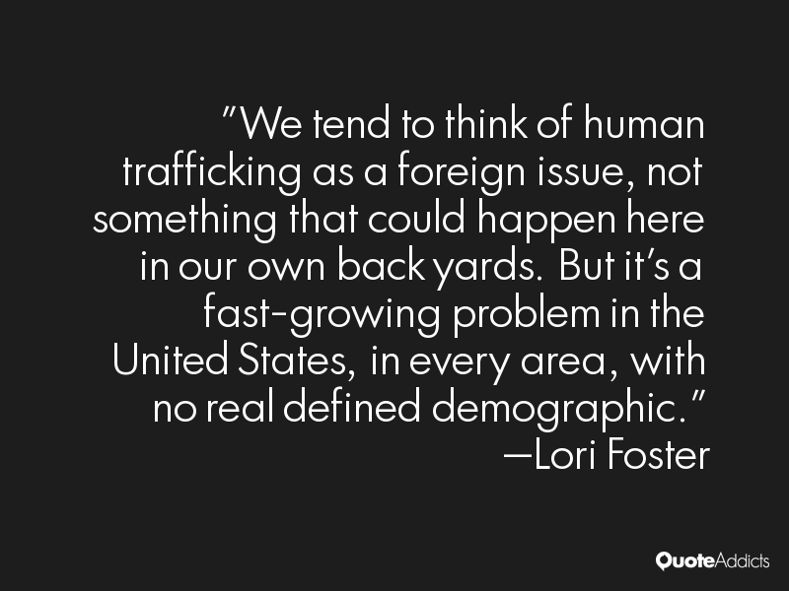
Notes:
How many of you have heard or read anything lately about Human Trafficking in your neighborhood or a neighborhood near you?

Slide 14
Common Myths about Human Trafficking
Human trafficking is not in our own backyards.
TRUE
FALSE
Notes:
So now is the time to use your paddles.
I am going to show some newspaper headlines and you will hold up the blue side of the paddle for TRUE and the yellow side of the paddle for FALSE.
Is it possible that HT is your own neighborhood?

Slide 15
TRUE or FALSE: Are these 2014/2015 headlines from Washington state, King County, or Seattle?
“Consumers, lawmakers push to end forced labor in fishing”
“ [Location] military officers sought in alleged human trafficking”
“ [Location] . . . woman accused of pimping teenage daughter”
“[Location] county man pleads guilty to pimping and raping
underage girls”
Notes:
FALSE – from Washington DC after 2,000 enslaved fishermen were recued in Indonesia – seafood they caught is sold to companies such as MARS and Nestle’s who are major producers of seafood-based pet foods in the US.
How many of you buy pet food that contains fish? Do you know who manufacture’s the food?
2) False – Thailand – Thailand has one of the poorest records on both sex and labor trafficking (one of only 23 countries Tier 3 – only other in East Asia and the Pacific region is North Korea.
3) TRUE – Snohomish County – December 2014 – detectives tracked the teen through Internet ads to motels in Everett, Edmonds and Fife when she was 15 year old. The mother knew what was going on and was complicit in the rape of a child for money. The daughter gave her mother about $2000 of her earnings.
Incidentally, Everett and Snohomish county have been at the forefront of the new and there is a lot going on in that area –
in June this year the county was investigating 45 ongoing human sex trafficking cases and Snohomish County currently has its own Human Trafficking Hotline.
There are plans to open home – Peoria Home – a 2-year program to help former sex workers rebuild their lives – topic on a Radio show – CAROL??
4) TRUE – Pierce County/Port Orchard - kept a 14 year-old and a 15 year-old runaways in rooms he kept at hotels, - gave them methamphetamines and beat them if they didn’t do what he said
Prosecutors said it was the most serious human trafficking case they handled.

Slide 16
“ [Location] spas labeled chronic nuisances amid prostitution
allegation”
“AP Investigation: Slavery taints global supply of seafood”
“Costco sued over claims shrimp is harvested with slave
labor: [Location] woman filed what may be the first such lawsuit
against the retailer over liability for the Thai fishing industry.”
Notes:
TRUE – Bellevue
False - Indonesia - but it has direct ties to the NW. Tainted fish can wind up in the supply chains of some of America’s major grocery stores, such as Kroger, Albertsons and Safeway, the nation’s largest retailer, Wal-Mart; and the biggest food distributor, Sysco.
It can find its way into the supply chains of some of the most popular brands of canned pet food, including Fancy Feast, Meow Mix and Iams. It can turn up as calamari at fine dining restaurants, as imitation crab in a California sushi roll or
as packages of frozen snapper relabeled with store brands that land on our dinner tables.
FALSE – this was actually a California woman but we also have Costco here.
– she cited California state laws that bar companies from making false claims about illegal conduct in the supply chain, including human right violations.
Costco purchases farmed prawns from Thailand which are fed a diet of cheap fish caught at sea with unpaid, forced labor. Thailand is the world’s 3rd biggest importer of seafood and employs 650,000 people ---- Costco is currently working with Thailand to resolve this - but did have a small drop in its stock price just after the article

Slide 17
“Sex offender accused of pimping teen from [Location] jail”
“Sex workers gather to fight sigma, advocate for rights”
“[Location] massage parlor probe nets 55 arrests”
“Teenage pimp sentenced to 17 years in prison”
“5 [Location] County residents charged Afghan girls force labor”
Notes:
TRUE – Spokane
TRUE – Seattle – 3 days of events in December 2014 to advocate for the adult industry put on by SWOP – Sex Worker Outreach Program. Their claim is that not all sex work is exploitive, - there are escorts, performers, strippers, and phone sex operators who willingly engage in their professions. Their mantra is “Rights, not rescue”. As for pimps, they say that women can do whatever they want with their money after they earn it.
TRUE – Bellevue
TRUE – Seattle gang member reported how he was taught to pimp out young girls by ‘selling them a dream’
TRUE – King County the girl was brought to the US at age 13 – had an arranged marriage – was kept out of school, threatened with harm to her and her family, and deportation, her documents were confiscated – she was
sexually abused and beaten.
Now age 16 – may be able to stay in the country on a T Visa – which is a visa that allows victims of human trafficking to remain in the US

Slide 18
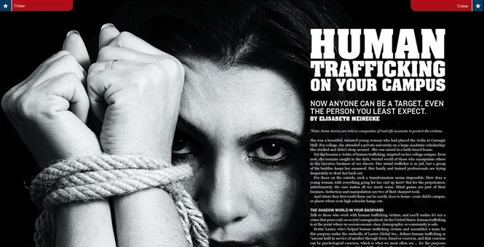
(1999) “A Slave’s Tale: Cruised, Abused, and Soon to be Deported”
“DEA: ” [Location] Doctor pimped women for extra cash”
Notes:
TRUE – Redmond - A retired Seattle police officer and his wife who was a successful illustrator of children’s book and had a prosperous travel agency decided they needed a ‘maid’ for their large sprawling estate in Redmond
– they divorced, arranged for a sham marriage but continued to live as man and wife
– brought a Helen, the 27-year old daughter of a Philippine rice farmer over on a fiancé visa, and the man married her in a Reno Nevada Chapel.
For 29 months she was the personal servant – housecleaner-cook-gardener-laundered- laborer –beautician. She got $300/mo. minus health and care insurance - $140/mo. The couple told people she was an exchange student or a relative. Helen ran away – the couple turned her in to immigration and got immunity for what they had done
The last information was that the couple had relocated to California and Helen was going to be deported.
2) TRUE – Bellevue.
Anesthesiologist – UW medical school graduate – making very good money
The DEA was investigating him thinking he was dealing prescription drugs because he was depositing huge sums of money at ATMs.
When what he was really doing was renting apartments for prostitutes, advertising online and and laundering money for his girlfriend's prostitution ring – and she was from Thailand.
In an 18 mo. period he paid nearly $11,000 for 116 advertisements on Backpage.com under the alias “Jesse Blue.
In one 8 month period $310,000 flowed through his suspicious bank account and at least $49,000 of that was wired to Thai bank accounts belonging to his girlfriend.
Agents found one woman who had been smuggled into the US – had already paid her “debt’ to the sex trafficking organization that smuggled her in and was not working as a pimp and helping manage other young wome
He and his girlfriend lived in a penthouse apartment in Bellevue and drove very expensive cars.
You probably wonder why I am going on and on about this – but this is My favorite story because I knew this doctor very well - I worked along side him in the OR at overlake hospital for many years.
3) Don’t know if this is happening on the SPU campus but this is an eye-opening article on how it could happen on any campus. The article includes a story of a young woman who came from a faith-based home, attended a private university on a large academic scholarship, played the violin at Carnegie Hall and became a victim of human trafficking.
-would be happy to share the online link to this

Slide 19
Common Myths about Human Trafficking
FALSE
Prostitution is the oldest profession
and a victimless crime.
Slavery is been around at
least as long, and, while
slavery as we have know it
had been somewhat
eradicated, Human Trafficking
is Modern Slavery and an abuse of basic
human rights.
TRUE
Notes:
As for this being a victimless crime, take the opportunity to listen to The State of Sex Trafficking in King County where a prostitution survivor only begins to touch on the damage that is done to women and girls

Slide 20
What is being done?
Nationally
(2015) Working to reward companies that have better policies
to prevent labor abuses
(2014) passed a bill sponsored by Washington’s U.S.
Rep. Dave Reichert to fight child sex trafficking
Businesses are becoming involved
Buyer Beware Program
Notes:
Bills are being passed
Businesses are looking at their supply chains –
Hershey’s has vowed to have 100% certified cocoa by 2020 - not purchasing cocoa from companies using child labor
Several hotel chains are training employees to identify and interrupt sex trafficking and sex buying.
Visa, MasterCard and American Express stopped working with Backpage so pimps cannot use those credit cards to pay for prostitution ads - Backpage.com –
Businesses are blocking websites so that workers can’t solicit at their work computers – or messages pop up when they do go to sites that warn them about the possible legal consequences of buying sex or
places to get help/support if they think this is a problem
The Buyer Beware Program is a country-wide effort to reduce the local demand for bought sex by targeting those who pay for sex.
Earlier this year, the law enforcement across King county announced that 2014 was the first year criminal charges for buying outpaced prostitution charges, making a shift in focus to the buyers .

Slide 21
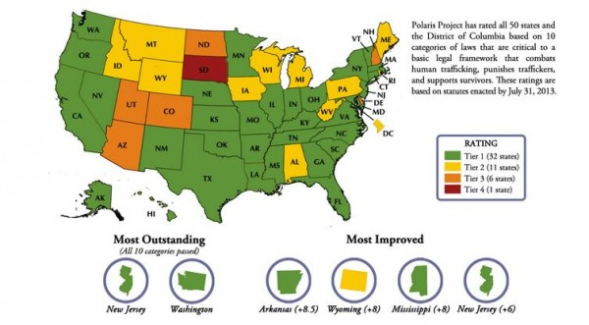
What is being done?
Washington State
Notes:
Washington State - is given top ratings for the work it has done – the Polaris project uses a similar tier system rating to the US Department of State based on 10 categories of laws that are critical to basic legal framework that combats HT, punishes traffickers, and support survivors.
Although this was based on statutes enacted in 2013 I think Washington continues to stand out in this area.

Slide 22
WA Senate Bill 6251 -Regulating advertising of commercial sexual abuse of a minor. Brief description: Created a new crime, making it illegal to knowingly publish an escort ad on-line or in print that involves a minor.
WA Senate Bill 6253 – Seizure and Forfeiture
Brief Description: Concerning seizure and forfeiture of property in commercial sexual abuse of a minor, promoting commercial sexual abuse of a minor, and promoting prostitution in the first degree crimes.
WA Senate Bill 5482 -Housing Bill
Sponsors: Jeanne Kohl-Welles
Brief Description: Proposes to direct affordable housing funding to victims of human trafficking.
Notes:
These are just a few bills passed in our State – there is a more comprehensive list on the Seattle Against Slavery website under the Advocacy section.
Jeanne Kohl-Welles – She represents the 36th Legislative District (in which I am fortunate enough to live so I can vote for her).
Main champion of anti-trafficking legislation in the state legislature and Thirteen of her anti-trafficking bills have been enacted into law since 2002.
You can also see many of the bills on the SAS website.

Slide 23
What is being done?
Counties and Locally
September 2015 – U.S. Attorney General Loretta Lynch announced that
Seattle would receive a $1.5 million grant to help fight human trafficking
Community Coalitions Against Trafficking (CATS)
Federal Way
Pierce County
Skagit County
South East King County
South West King County
Thurston County
Notes:
WE are being rewarded for what we have accomplished so far –
And Communities have become very aware that law enforcement was not going to be able to take HT on its own and are taking action

Slide 24
BEST – Business Ending Slavery and Trafficking
Organizations and Resources for Survivors
Seattle Against Slavery **Trafficking Prevention for Schools**
National Human Trafficking Resource Hotline (NHTRH)
Polaris Project
Washington Anti-trafficking Response Network
Organization for Prostitution Survivors
API Chaya
Refugee Women’s Alliance
YouthCARE
Real Escape From the Sex Trade (REST)
Notes:
BEST – was established in 2012 and in 2015 joined King County business leaders and national employees to launch the 1st public and private partnership in the nation to work across industries – there are currently 18 employers representing 125,00 employees in this alliance.
There are several very active organizations and resources for survivors
SAS - – again I recommend visiting SAS website
Seattle Against Slavery (SAS) is a grassroots coalition working to make a slave-free world, one city at a time. Uniting community-based abolition activists, local and national non-government organizations, government agencies, and other coalitions, SAS seeks to raise human trafficking awareness and mobilize the public to better advocate for victims, enhance survivor care, promote legislation to combat human trafficking, and help service providers build capacity.
Mission
To foster collaboration in the fight against human trafficking through education, advocacy, and mobilization.
Vision
To end slavery around the world, one city at a time.
In particular, read about one of their newest programs - High School Program
Trafficking Prevention for Schools
It is the first curriculum of its kind and works to empower young men and women to become allies in the fight against human trafficking.
Trafficking Prevention for Schools aligns with health and safety curricula already being taught at the middle school level and meets several Common Core State Standards. The program is designed so that the groups of young women and men

Slide 25
As an individual, what can you do?
Educate (Yourself and Others)
Report
Advocate
Contact Your Congressional Representatives
Vote
Volunteer
Notes:
Educate – you have a start coming here today
Volunteer – SAS currently has posting for volunteers to help with the Trafficking Prevention for Schools – faculty? Anyone?

Slide 26
As an individual, what can you do?
Educate
How might you identify possible Human Trafficking?
Ask Questions
Read/watch/listen to the news
Listen to a 90-minute audio “The State of Sex
Trafficking in King County”
**Tonight – See the movie “ The Longest Night”**
** Visit any of the websites provided for you today**
Notes:
Link for the audio on paddle -
A panel discussion on regional sex trafficking featuring leaders, experts and activists to engage and educate local communities about the trafficking of children but more importantly to challenge individuals and the communities to find ways to prevent sex trafficking from happening in the first place, especially by addressing demand.

Slide 27
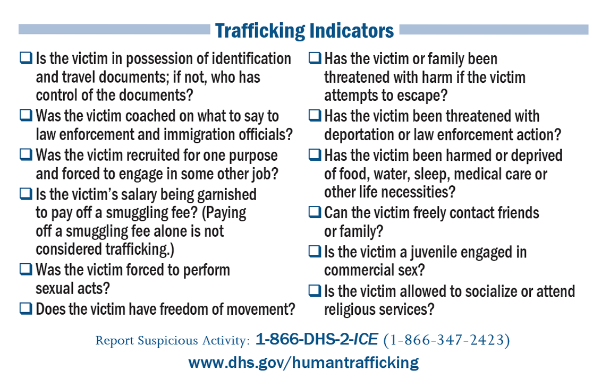
Report
Notes:
How would you know what to look for?

Slide 28
As an individual, what can you do?
Report
Call the National Human Trafficking Resource Center (NHTRC)
toll-free hotline at 1-888-373-7888:Call Specialists are available
24/7 to take reports of potential human trafficking.
All reports are confidential and you may remain anonymous.
Seattle Police Department
Redlight Traffic app
Washington State Department of Health:
Identifying and Responding to Victims of Human Trafficking
http://www.doh.wa.gov/Portals/1/Documents/2300/IdentifyingVictimsofHumanTrafficking.pdf
Notes:
SEATTLE –
Redlight traffic app –
Anyone with a smartphone can do their part in the fight against human trafficking thanks to new technology that allows users to report suspicious activity.
The application was developed in the Seattle area by an Eastside businessman went to a Seattle Kiwanis Club luncheon and heard two King County Sheriff’s detectives talk about HT in Seattle – where he heard that Greater Seattle is known to be one of the worst areas in America when it comes to human trafficking. Police say hundreds of children are worked every day in King County.
He was in a leadership-enrichment program and decided to do his project on adapting technology to fight the HT.
He and his wife developed the GPS-based app is called Redlight Traffic.
It's a free download designed to help police identify survivors and suspects in the world of sex slavery - . "
It allows users to send in pictures, pinpoint a problem area on a map and answer questions to help police. The information is sent directly to Redlight Traffic, which forwards reports to appropriate police agencies.
"There are agencies who are actively looking at the reports and have cases that are open because of these reports,

Slide 29
As an individual, what can you do?
Visit the Seattle Against Slavery website and discover:
How many slaves work for you?
Which brands address modern slavery?
BEST: Business Ending Slavery & Trafficking.
See what local businesses are doing.
Notes:
So where do you start? On the back of your paddles are what Carol and I see as the 3 major sources for information –
Now I am going to turn it over to Carol who will talk a more on The SAS site

Slide 30
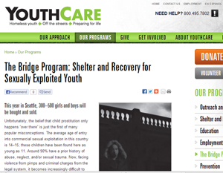
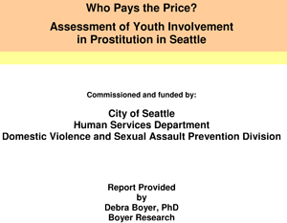
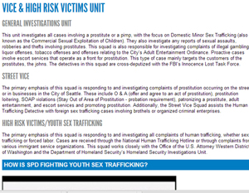
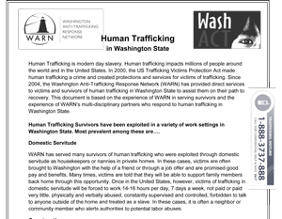
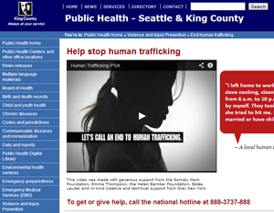
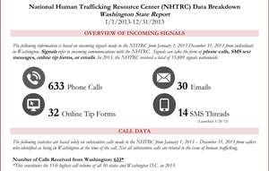
Notes:
Multiple valuable resources on the SAS website

Slide 31
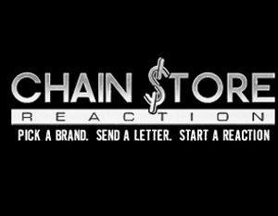
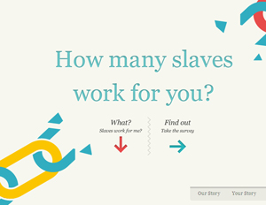
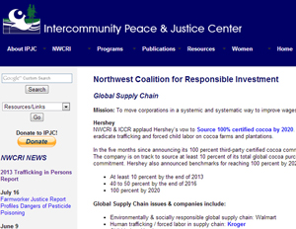
Notes:
Show ‘How many slaves ..’ and/or ‘ Free to Work’ (See which brand address modern slavery)

Slide 32
What is happening at SPU?
Working with Seattle Against Slavery
Elena Raney and Grace Lane
Set Free Movement

Slide 33
A Nurse’s Response to Human Trafficking
Created by Seattle Pacific University Nursing Students in partnership
with Seattle Against Slavery
Kirsten Nelson, Elena Raney, Faith Sairez, Danae VerMulm, Grace Lane

Slide 34
Set Free
This club focuses on equipping people through
spiritual development and education.
Nathan Bennett and Suzi Spooner

Slide 35
References/Links
Business Ending Slavery & Trafficking http://www.bestalliance.org/
H.E.A.T.Watch (Stop Human Exploitation and Trafficking http://www.heatwatch.org/
Polaris Project www.polarisproject.org
Meinecke, E. (2013). Human Trafficking on your campus: Now anyone can be a target, even the person you least expect. Town Hall, 45-49.
http://mnchildprotectionleague.com/wp-content/uploads/HumanTraffickingArticleFromTownHallMag.pdf
National Human Trafficking Resource Center http://www.traffickingresourcecenter.org/
Seattle Against Slavery http://www.seattleagainstslavery.org/
Senator Jean Kohl-Welles http://sdc.wastateleg.org/kohlwelles/
The Seattle Times http://www.seattletimes.com/
The State of Sex Trafficking in King County (audio) http://kuow.org/post/state-sex-trafficking-king-county
U.S Department of State: Trafficking of Persons Report 2015 http://www.state.gov/j/tip/rls/tiprpt/2015/
Notes:
The 3 most beneficial for beginners! On your paddle –
If you have any questions about anything presented here today please contact Carol or I

Slide 36
DECLARATION OF RELIGIOUS LEADERS AGAINST MODERN SLAVERY
We, the undersigned, are gathered here today for a historic initiative to inspire spiritual and practical action by all global faiths and people of good will everywhere to eradicate modern slavery across the world by 2020 and for all time.
In the eyes of God,* each human being is a free person, whether girl, boy, woman or man, and is destined to exist for the good of all in equality and fraternity. Modern slavery, in terms of human trafficking, forced labour and prostitution, organ trafficking, and any relationship that fails to respect the fundamental conviction that all people are equal and have the same freedom and dignity, is a crime against humanity.**
We pledge ourselves here today to do all in our power, within our faith communities and beyond, to work together for the freedom of all those who are enslaved and trafficked so that their future may be restored. Today we have the opportunity, awareness, wisdom, innovation and technology to achieve this human and moral imperative.
12/2/2014
Notes:
*The Grand Imam of Al Azhar uses the word “religions.”
**The term “crime against humanity” has a particular legal meaning that the U.S. Department of State does not view as being implicated here.
In closing, we would like to once again read the declaration of religious leaders against modern slavery and invite you to read aloud with us -

