Slide 1
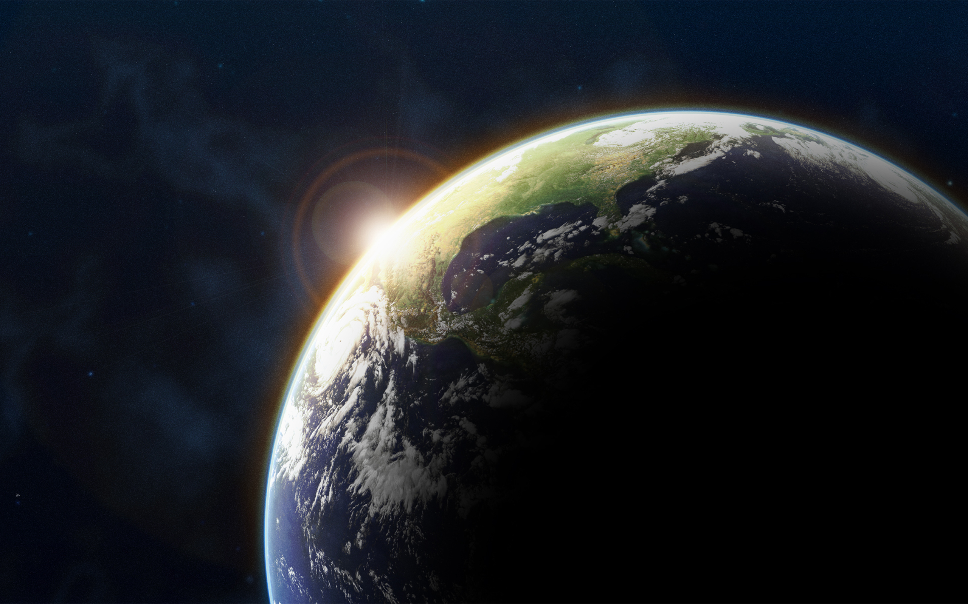
From Good to Groaning
Theological and Scientific Perspectives on Ecological Justice
Dr. Eric Long
Dr. Mike Langford
God saw all that he had made, and it was very good. And there was evening and there was morning – the sixth day. (Gen 1:31)
We know that the whole creation has been groaning as in the pains of childbirth right up to the present time. (Rom 8:22)

Slide 2
Some theological foundations…
The intrinsic goodness of creation
The denial of duality
The endurance of the earth

Slide 3
Creation is good!
“Maybe humans are good, and the rest is just there for us to use.”
Genesis 1
“And God saw that it was good.”
“God saw everything that he had made, and indeed, it was very good.”
Notes:
Humans are actually not specifically called “good” at all. They are good, and it seems that there is a unique sort of relationship between God and humans, but their intrinsic goodness is the same as the earth’s – it is good because it was created by God

Slide 4
Creation is good!
“Maybe humans are good, and the rest is just there for us to use.”
Genesis 1
“God said to them, ‘Be fruitful and multiply, and fill the earth and subdue it; and have dominion over the fish of the sea and over the birds of the air and over every living thing that moves upon the earth.’”
Radah – to rule subjects … but how?
Notes:
Obviously we are not ruling over subjects in creation; often they rule us. So what does this mean?
Has to be taken in context; interpreted by other verses (like Gen 2), and how God does not appreciate other radah-ers in Scripture.
Psalm 72 - radah
Dominion is not domination

Slide 5
Creation is good!
“Maybe humans are good, and the rest is just there for us to use.”
Genesis 2
“The Lord God took the man and put him in the garden of Eden to till it and keep it.”
Abad – to tend, to cultivate
Shamar – to exercise great care over

Slide 6
Creation is good!
“Maybe humans are good, and the rest is just there for us to use.”
Genesis 9:12-13
“God said, ‘This is the sign of the covenant that I make between me and you and every living creature that is with you, for all future generations: I have set my bow in the clouds, and it shall be a sign of the covenant between me and the earth.”
We are attached to the earth

Slide 7
The natural is good!
“But isn’t spiritual reality – heaven and our souls – good, and the rest sort of less than good?”
Plato
“Dualism”
Judaism
Hellenistic influence

Slide 8
The natural is good!
“But isn’t spiritual reality – heaven and our souls – good, and the rest sort of less than good?”
Incarnation
Resurrection

Slide 9
It’s not going anywhere!
“But what does it matter if it is all going to burn anyway?”
“Eschatology”
Where in the bible is this claim made?
Persecution
Popular culture
Lord’s Prayer
Notes:
1 Peter 3:10
Fire is symbol of purification
Isaiah 65:17, 66:22, 2 Peter 3:13, and Revelation 21:1 reference the “new earth”

Slide 10
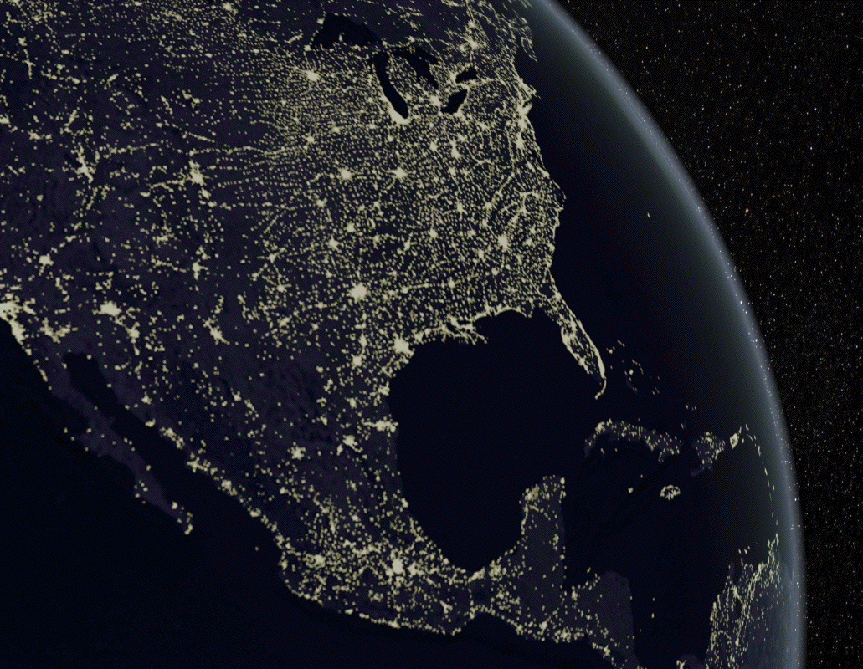
Some questions…
Is there a problem?
Why is there a problem?
What is affected by the problem?
Now what?

Slide 11
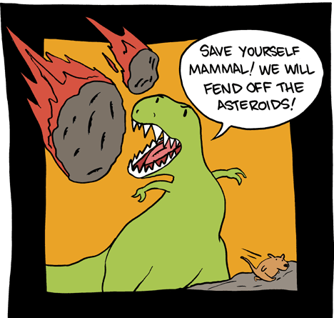
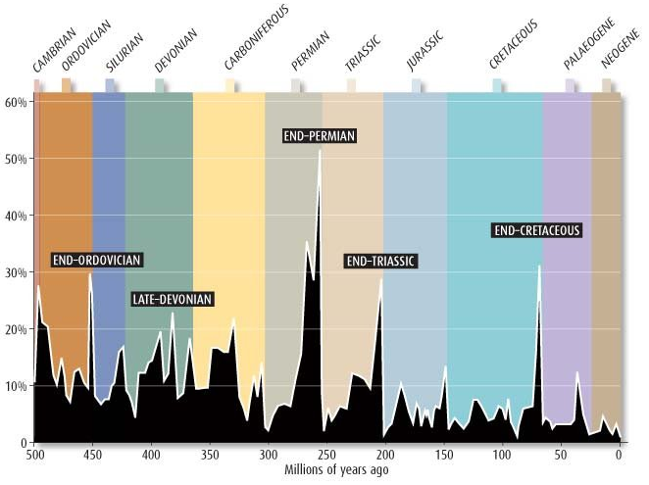
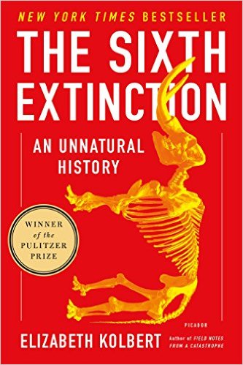
1. If “good” = “ordered”, is there a problem?
Untimely loss of biodiversity
Extinction is normal (and OK)
Current extinction rate not OK
Why so high?
Extinction Intensity
“Normal” rate of extinction
Notes:
Mass extinction: ~75% or more of species lost in a geologically short period of time (millions of years)
Current extinction rates are estimated to be 100 – 10000 times the normal background rate.

Slide 12
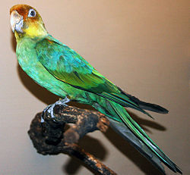
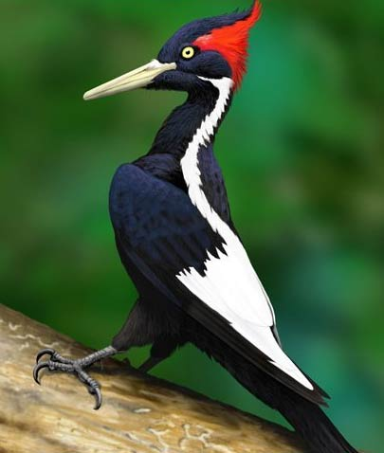
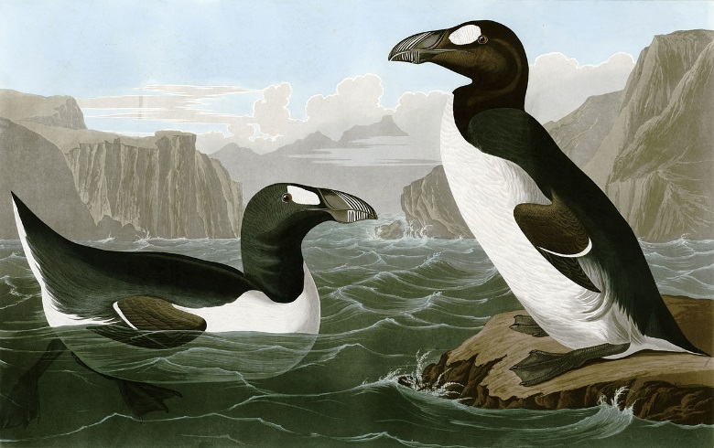
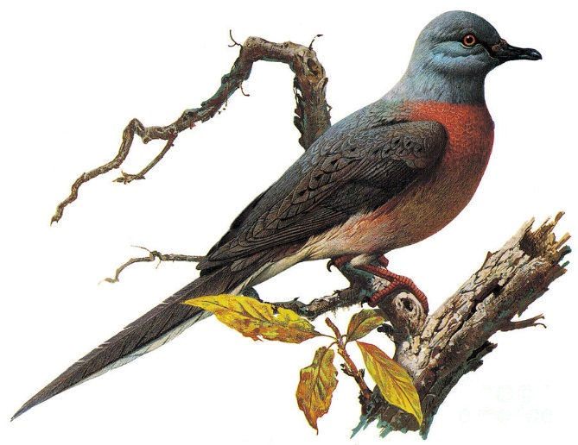
1. If “good” = “ordered”, is there a problem?
Untimely loss of biodiversity
Extinction is normal (and OK)
Current extinction rate not OK
Why so high?
Passenger Pigeon
Carolina parakeet
Ivory-billed woodpecker
Great auk
Notes:
Mass extinction: ~75% or more of species lost in a geologically short period of time (millions of years)
Current extinction rates are estimated to be 100 – 10000 times the normal background rate. Mostly due to overharvest and habitat degradation (i.e., humans)

Slide 13
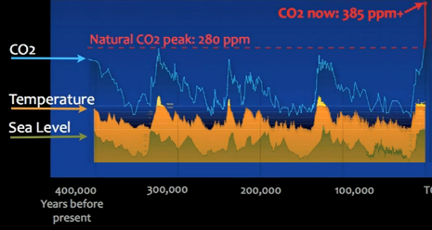
1. If “good” = “ordered”, is there a problem?
Untimely loss of biodiversity
Extinction is normal (and OK)
Current extinction rate not OK
Why so high?
Human-caused global climate change
The climate does change (and that’s OK)
Current rate of change is not OK
398 ppm
Today

Slide 14
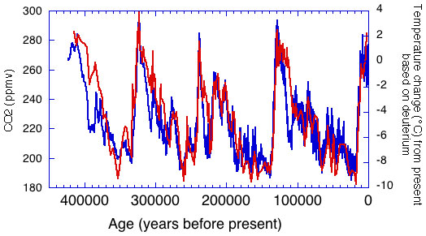
1. If “good” = “ordered”, is there a problem?
Untimely loss of biodiversity
Extinction is normal (and OK)
Current extinction rate not OK
Why so high?
Human-caused global climate change
The climate does change (and that’s OK)
Current rate of change is not OK
Why so hot?
398 ppm
Today
Notes:
CO2 in red, temperature in blue

Slide 15
1. If “good” = “ordered”, is there a problem?
Untimely loss of biodiversity
Extinction is normal (and OK)
Current extinction rate not OK
Why so high?
Human-caused global climate change
The climate does change (and that’s OK)
Current rate of change is not OK
Why so hot?
830 Scientists
120 Countries
9200 Studies
Warming of the climate system is unequivocal”
“It is extremely likely (more than 95% sure) that more than half of the observed increase in global average surface temperature from 1950 – 2010 was caused by anthropogenic [factors]”
~IUCN 2013

Slide 16
2. If “good” = “ordered”, is there a problem?
why
Untimely loss of biodiversity
Extinction is normal (and OK)
Current extinction rate not OK
Why so high?
Human-caused global climate change
The climate does change (and that’s OK)
Current rate of change is not OK
Why so hot?
Overharvest
Habitat destruction
Over-use of resources
Ignorance
Short-sightedness
Selfishness
Notes:
Selfishness is a factor of both anthropocentrism and individualism

Slide 17
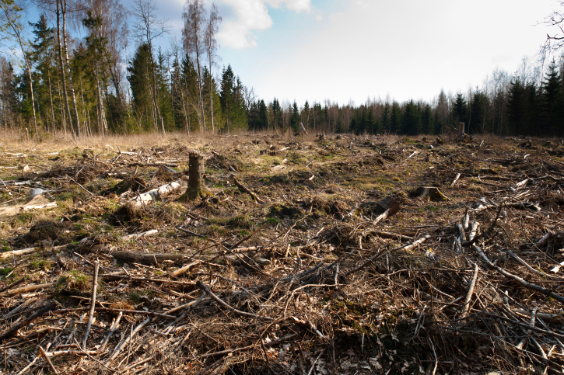
3. What is affected by the problem?
The natural world (obviously)
Gen 2:15
Abad
Shamar
Notes:
Need quotes from encyclical.
If God cares for the well-being of the natural world AND God cares about the well-being of humans, AND our selfishness is causing unfair, unjust harm to both, THEN I contend that God grieves.
What is the proper view of the God/Human/Earth relationship?

Slide 18
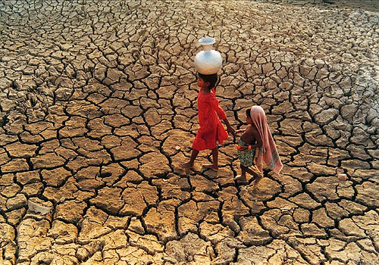
3. What is affected by the problem?
Who
The natural world
Other people
We are faced not with two separate crises, but rather with one complex crisis which is both social and environmental.
~Pope Francis, 2015
Strategies for a solution demand an integrated approach to combating poverty, restoring dignity to the excluded, and at the same time protecting nature.
Notes:
Need quotes from encyclical.
If God cares for the well-being of the natural world AND God cares about the well-being of humans, AND our selfishness is causing unfair, unjust harm to both, THEN I contend that God grieves.
What is the proper view of the God/Human/Earth relationship?

Slide 19
3. What is affected by the problem?
Who
If God cares about these,
The natural world
Other people
God?
and God cares about them,
but our:
Ignorance
Short-sightedness
Selfishness
God grieves.
Cause unjust harm to both,
Notes:
Need quotes from encyclical.
If God cares for the well-being of the natural world AND God cares about the well-being of humans, AND our selfishness is causing unfair, unjust harm to both, THEN I contend that God grieves.
What is the proper view of the God/Human/Earth relationship?

Slide 20
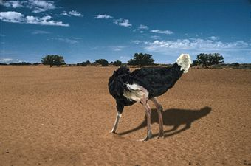
4. Now what?
Awareness
Notes:
Forest Council

Slide 21
4. Now what?
Awareness
Advocacy
Notes:
Forest Council

Slide 22
4. Now what?
Awareness
Advocacy
Consumer Consciousness
For non-necessities: reduce volume of consumption
For necessities: source responsibly
Clothes: buy used
Food: buy “sustainable” (or grow it!)
Notes:
Forest Council

Slide 23
Want to learn more?
Wow! A beautiful case for integrated social and environmental justice
‘nuff said
Accessible read on the current state of biodiversity loss
A clear call for Biblically informed creation care

