Slide 1
Common learning every day: northwest native American perspectives on sustainability education Richard Scheuerman and Greg Fritzberg with Carrie Jim Schuster
SPU Day of Common Learning
October 25, 2016
scheur@spu.edu
gregf@spu.edu

Slide 2
DIFFERING PERSPECTIVES
“[Y]ou must talk about practicable things. Twenty times over you repeat the earth is your mother, and about the chieftainship of the earth. Let us hear it no more, but come to business.”
--U. S. General O. O. Howard to Lapwai Council Nez Perce Chiefs (1863)
“With the exception of a few pioneering naturalists, our ancestors often failed to comprehend the ecology of the land or the virtues of the people who learned to live sustainably on it.”
--David Orr, Earth in Mind: On Education, Environment, and the Human Prospect (1994)

Slide 3
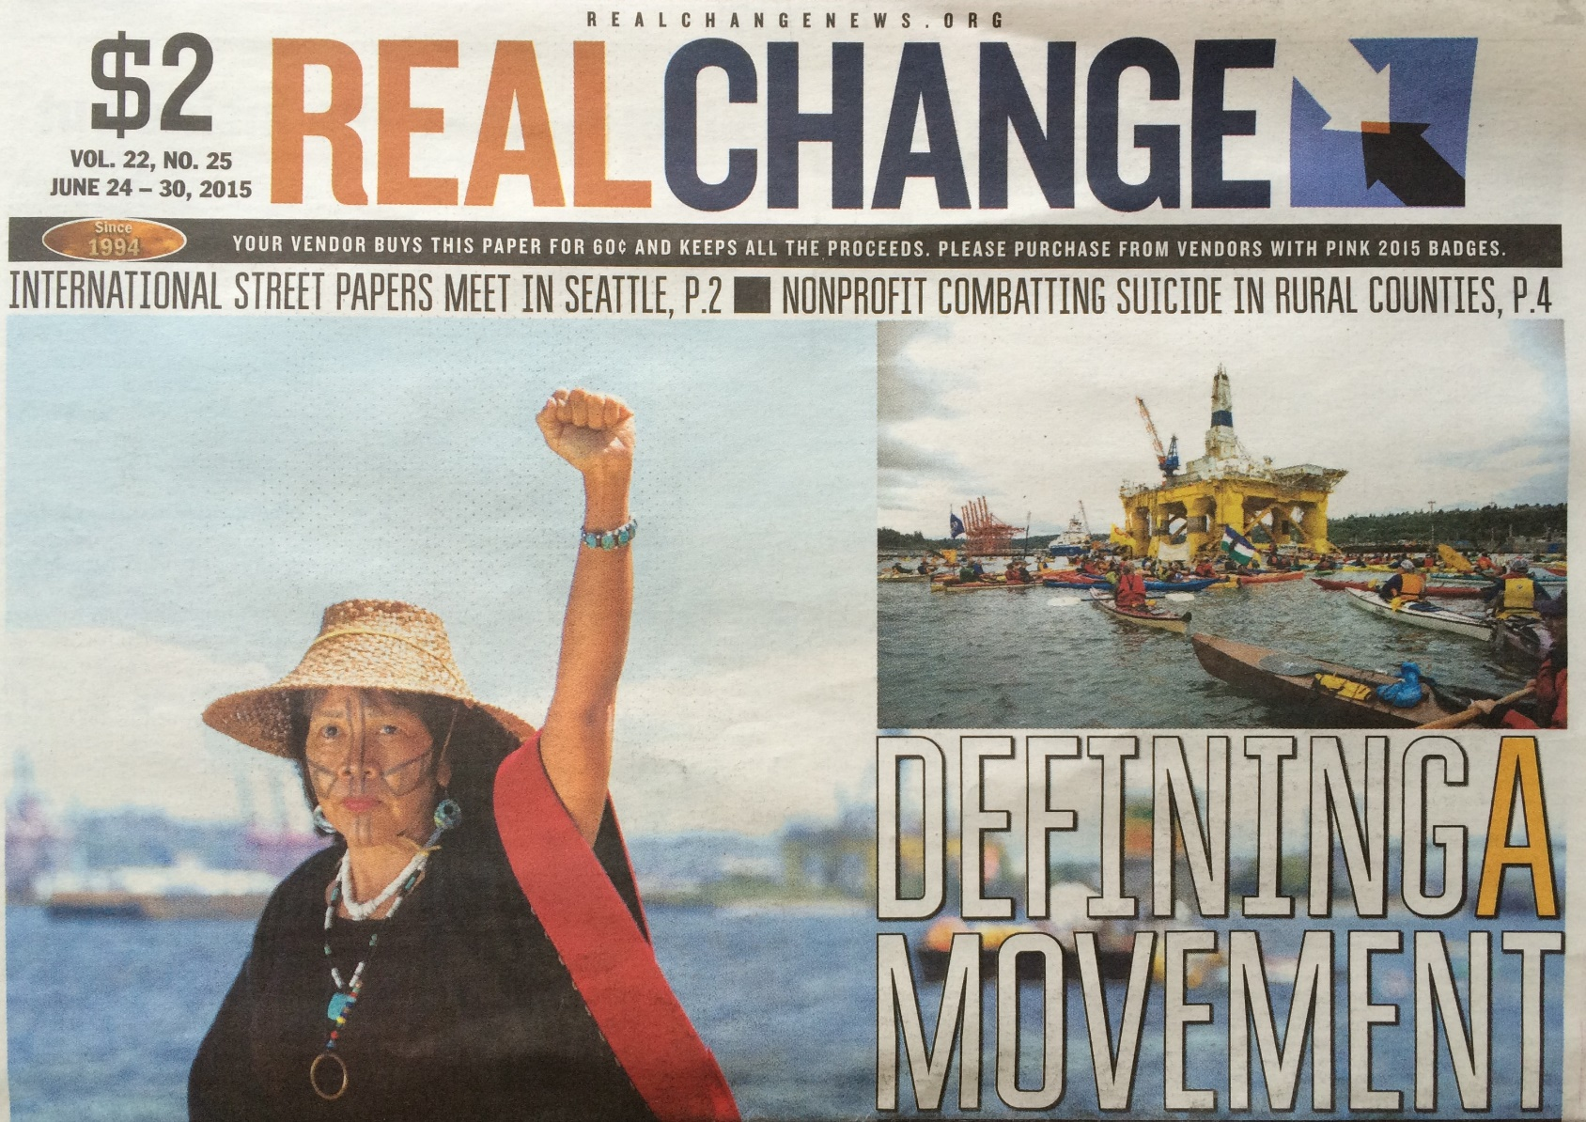
“FESTIVALS OF RESISTANCE” Seattle (2015), standing rock (2016)

Slide 4
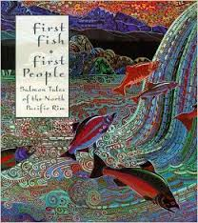
FIRST FISH, FIRST PEOPLE
Educators and elders from Pacific Rim nations hosted here at SPU and elsewhere for dialogue about sustainability and traditional salmon cultures—
--Japanese Ainu
--Russian Ulchi and Nyvkh
--American Sahaptin and Salish
--Canadian Okanagan
“Words and images offering a prayer that
our waters and lands may flourish.”

Slide 5
THE WASHINGTON SUSTAINABILITY EDUCATION ENDORSEMENT
2009-10 Washington Professional Educators Standards Board approves a teaching endorsement in Environmental and Sustainability Education (ESE) for K-12 teachers
Standard 1: Ecological, Social, and Economic Systems
Interconnections and health
Standard 2: Natural and Built Environments
Structures, components, processes
Standard 3: Sustainability and Civic Responsibility
Decisions and actions promoting sustainability

Slide 6
OUR FRAMEWORK FOR PLACE-BASED SUSTAINABILITY STUDY (NB: HB 1495/2005)
1) Invite tribal elders into classrooms as important cultural resources, historians, and philosophers
2) Find primary texts that delve into sustainability themes and go beyond the prior knowledge of many students
3) Teach students to develop the reading lens of a tribal elder
4) Read across texts for sustainability themes
5) Guide students to understanding how tribal leaders have enhanced local ecosystems
“Tribes have their own literatures, histories, and approaches… [which offer] guiding questions instead of pat answers.”
--Washington Office of Public Instruction

Slide 7
Core principles of sustainability
“Our ancestors often failed to comprehend the ecology of the land or the virtues of the people who had learned to live sustainably on it.”
--David Orr, Earth in Mind: On Education & the Human Prospect
Above: Lower Chain Lake near Stevens Pass, Cascade Range

Slide 8
1. Environmental knowledge
Natural resources are to be respectfully used and managed which requires intimate understandings of relationships among natural systems. Desire to get more than one needs jeopardizes the wellbeing of life and land.
Pahto (Mt. Adams, Cascade Range)

Slide 9
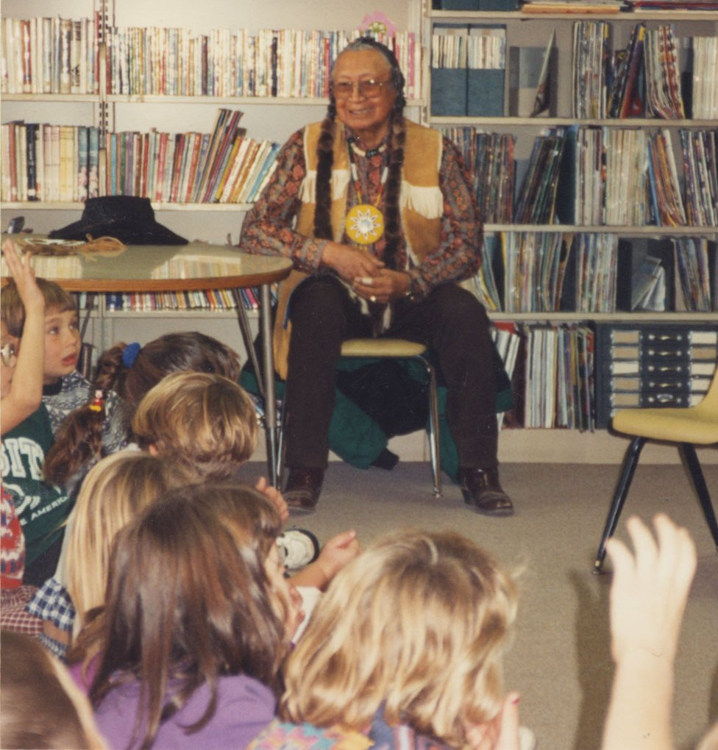
2. Language and Moral Literature
Words contain special force implicit in sounds associated with nature, life forms & landscape. Cultural knowledge transmitted through myth (ancient), tale (experiential) & lore (anecdotal) relates to place & culture. These experiences develop
Right: Ellison Schuster & Friends
moral sensibilities for respect, stewardship & cooperation.

Slide 10
3. Artistic expression
Material culture items are fashioned from natural materials and valued for aesthetic and sacred signifi-
cance. Motifs are often associated with use, origin, or individ-
ual & family identity.
Left: Jim Family Cedar Root Basket

Slide 11
4. Ceremony and celebration
Songs, feasts & celebra-
tions recognize and
commemorate relation-
ships in community with one another & among generations. Ceremonies recognize creation obligations to reveal our place and role in the web of life.
Right: Snake River Drummers

Slide 12
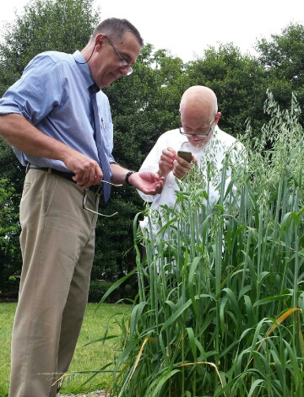
5. Balanced innovation
Change can be beneficial when promoting well-being within nature and among global cultures (vs. short-term gain). Technological progress is to be considered within the limits of moral obli-
gations for care of creation.
Right: White House Test Garden heritage grains with Dr. Stephen Jones

Slide 13
6. PERVASIVE SPIRITUALITY
Human experience is inextricably linked to sacred obligations and kinship within creation. Humans are to be proprietors of the land who share assets and knowledge benevolently with the community.

Slide 14
7. Cyclical time
Aspects of physical and spiritual experience reoccur in a cyclical process that transcends time and circumstance and is not bound by linear progression. Events from the time of myth and personal qualities of persons from former generations are sometimes revealed in dreams or in the sounds of nature.
Right: Itatimat Time Ball

Slide 15
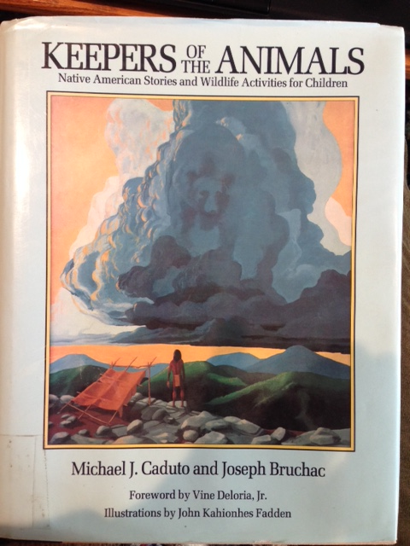
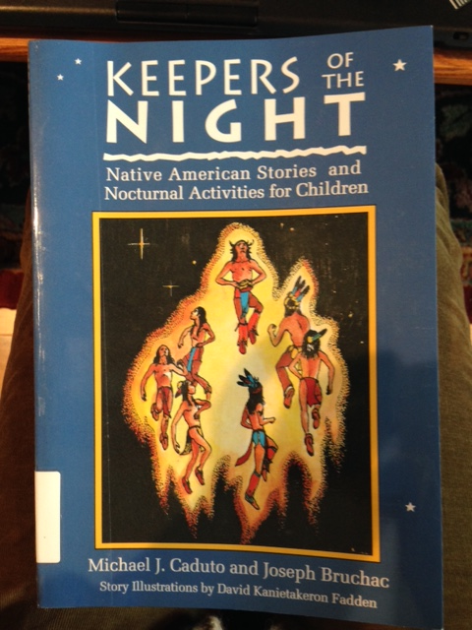
WIDER READING TO GO DEEPER
Michael Caduto & Joseph Bruchac (a member of the Abenaki Tribe)
Keepers of the….series of 3 books
1989
1991
1994

Slide 16
Caduto & Bruchac Keepers of the….Series

Slide 17
Caduto & Bruchac Keepers of the Animals
Notes:
Here is a portion of the TOC for Keepers of the Animals
A sample story is “The Rabbit Dance”

Slide 18
“Some people say we are extinct, but we are still here….” –Carrie Jim Schuster

Slide 19
references
Caduto, M.J., & Bruchac, J. (1989). Keepers of the earth: Native American stories and environmental activities for children. Golden, CO: Fulcrum.
Caduto, M.J., & Bruchac, J. (1991). Keepers of the earth: Native American stories and wildlife activities for children. Golden, CO: Fulcrum.
Caduto, M.J., & Bruchac, J. (1994). Keepers of the earth: Native American stories and nocturnal activities for children. Golden, CO: Fulcrum.
Daniels, H. & Zemelman, S. (2014). Subjects matter: Every teacher’s guide to content reading (2nd ed.). Portsmouth, NH: Heinemann.
Green, T.A. (ed.). (2009). Native American folktales: Stories from the American Mosaic. Westport, CT: Greenwood Press.

Slide 20
references
Lavere, D.B. (2008). The quality of pedagogical exercises in U.S. history textbooks. The Social Studies, 99(1), 3-8.
Shield, M., & Dole, S. (2013). Assessing the potential of mathematics textbooks to promote deep learning. Educational Studies in Mathematics, 82(2), 183-199.
Smagorinsky, P. (2008). Teaching English by design: How to create and carry out instructional units. Portsmouth, NH: Heinemann.
Wheeler, G., & Vavrus, J. (2009). Washington State K-12 integrated environmental and sustainability education learning standards. Olympia, WA: Office of Superintendent of Public Instruction. Retrieved from http://www.k12.wa.us/EnvironmentSustainability/pubdocs/ESE
Standards.pdf.

