Slide 1
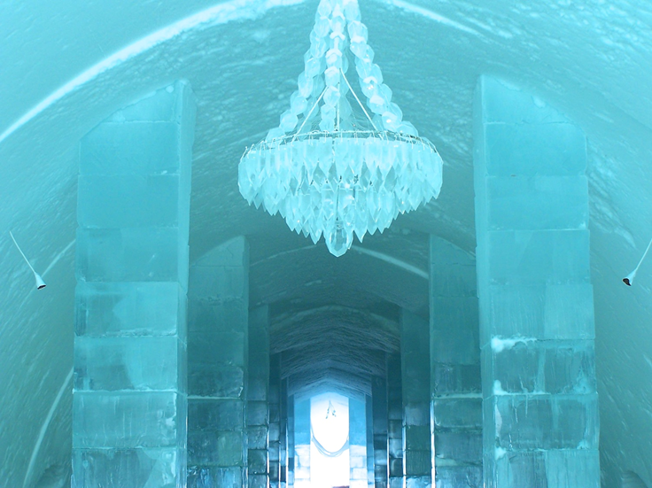
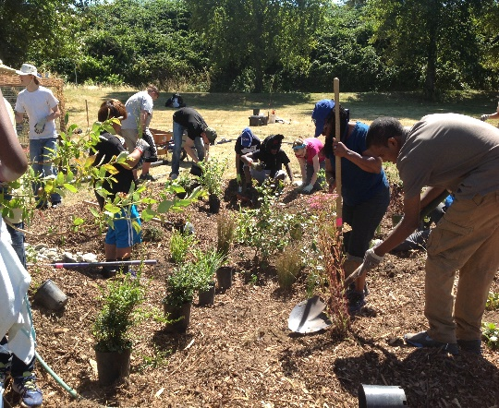

Learning in ice hotels and p-patches:
The classroom as a generative, collaborative community.
Kara Gray and Lane Seeley, Physics

Slide 2
Ice-Hotel
P-Patch
Awesome
Cold
Sanitized
Unfamiliar
Frozen in time
Created by experts entertainment of visitors
Messy
Organic
Everyone brings their ideas, gifts and priorities
Everyone collaborates to promote growth and provide nourishment
How have you experienced learning communities as Ice-Hotels and P-Patches?

Slide 3
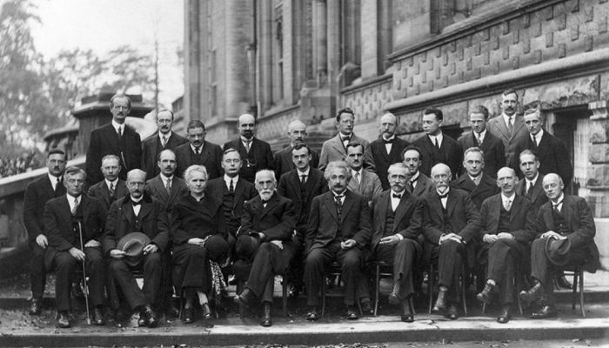
Whose discipline is it anyway?
discipline
control that is gained by requiring that rules or orders be obeyed and punishing bad behavior
behavior that is judged by how well it follows a set of rules or orders
disciple
one who accepts and assists in spreading the doctrines of another
convinced adherent of a school or individual

Slide 4
Physics Degrees by Race

Slide 5
Percent of Bachelor’s Degrees Earned by African Americans, by Major
www.aps.org
© 2015, American Physical Society

Slide 6
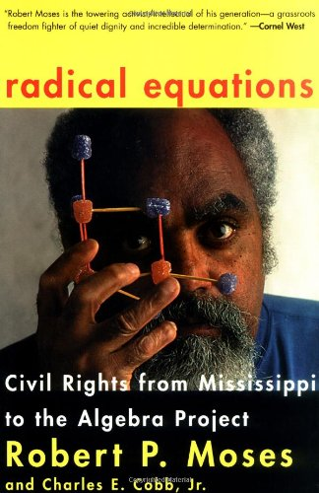
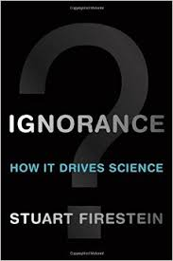
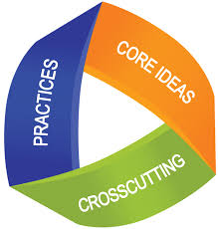
Strategies for Inclusion
Ideas before vocabulary
  People talk before feature talk
Questions before answers
  “You’ll know you’ve asked a great question when it leads to other questions”
Practices before content

