Slide 1
Presenting and Preserving Your Scholarship with Digital Commons @ SPU
November 13, 2013
Kristen Hoffman and Michael Paulus

Slide 2
Overview
What is self-archiving
Why self-archive
Digital Commons @ SPU
How do I self-archive
Questions

Slide 3
What is self-archiving?
Depositing a digital document to a public website
Personal website
Disciplinary repository
Institutional repository: Digital Commons @ SPU
Published article

Slide 4
What is self-archiving?
Preprints
Postprints and publisher PDFs
Copyright Transfer Agreement
Publisher policy
Publisher’s website
SHERPA/RoMEO
Publisher permission
Author addendum (prior to publication)
SPARC or others
APA Journals
Cambridge
Brill
SAGE

Slide 5
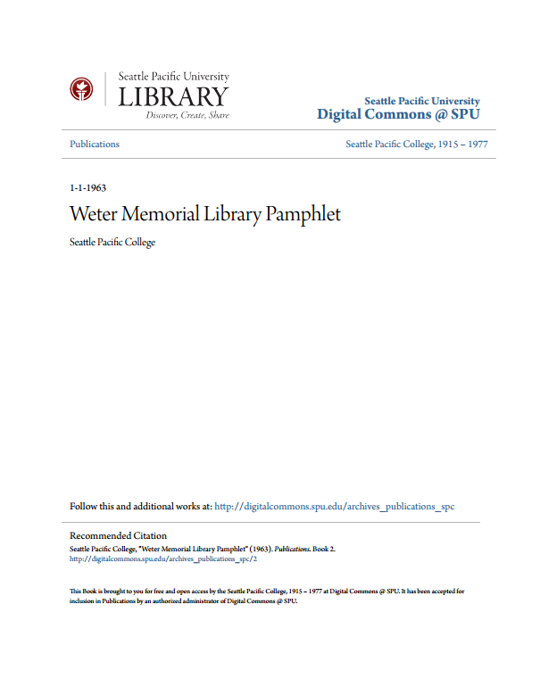
Why self-archive?
Increases
Visibility
Accessibilty
Usage
Impact
“Self-Archiving FAQ.” (2012). Retrieved from http://www.eprints.org/openaccess/self-faq/#Why-self-archive

Slide 6
Why self-archive?
Legal
Peer review
Publishing
Time

Slide 7
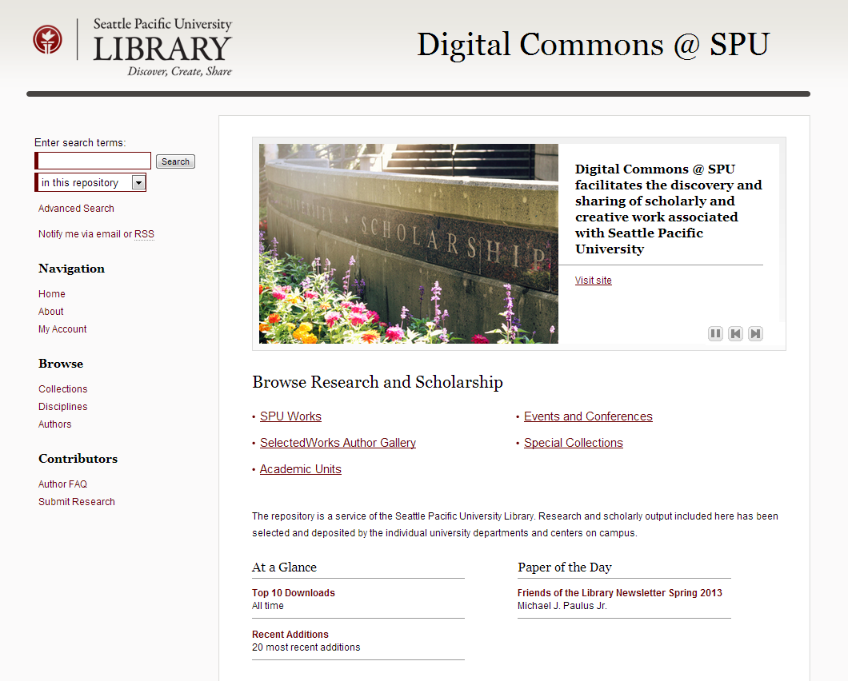
digitalcommons.spu.edu
Articles
Book chapters
A/V files
Images
Conference papers
Datasets
Course content
Musical scores and recordings
Creative works
Journals
University publications
Notes:
“Green” OA; collected scholarship of SPU to share with the community and world

Slide 8
digitalcommons.spu.edu
Personal info
Files
Links
Social media
Networks
Metrics

Slide 9
How do I self-archive?
http://digitalcommons.spu.edu/
My Account and Sign in with your SPU account
Submit Research
SPU Works
Pre-print: fill out basic information about the article and upload;
Post-print or publisher's PDF: verify CTA or journal policy
Link to publisher's version of record (should be automatic)
10 minutes per article
Articles are not immediately posted; an administrator will review submissions and post to site

Slide 10
More information
Digital Commons @ SPU: http://digitalcommons.spu.edu/
Self-archiving FAQ's: http://www.eprints.org/openaccess/self-faq/
Sherpa/RoMEO (publisher policies on self-archiving): http://www.sherpa.ac.uk/romeo/search.php
Publisher self-archiving statistics: http://www.sherpa.ac.uk/romeo/statistics.php
Effect of Open Access and Downloads: http://opcit.eprints.org/oacitation-biblio.html
Self-Selected or Mandated, Open Access Increases Citation Impact for Higher Quality Research (2010): http://ezproxy.spu.edu/login?url=http://search.ebscohost.com/login.aspx?direct=true&AuthType=ip&db=aph&AN=59308656&site=ehost-live

