Slide 1
Digital and Information Equity: Discerning the Issues & Solutions in Seattle
Liz Gruchala-Gilbert, College of Arts and Sciences and School of Education Librarian; Associate Professor
Kristen Hoffman, Psychology and Scholarly Communications Librarian; Instructor
Notes:
Unless otherwise noted, this presentation is licensed CC BY NC 4.0.
Abstract: Abstract: Seattle's economy is fueled by the tech industry, yet many citizens do not have access to internet service, devices, and basic technology training. Join librarians and Information Studies professors Kristen Hoffman and Liz Gruchala-Gilbert in exploring Digital and Information Equity in Seattle — what it is, who is impacted, and what solutions are being implemented.
Introduce selves; why we got involved
Photo: taken by Jeff Hoffman; view of Seattle Center from the top of the Space Needle

Slide 2
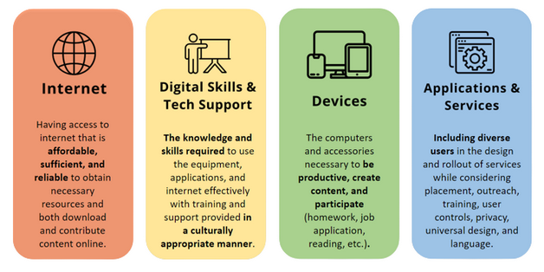
Digital Equity
Definition from the City of Seattle:
We envision Seattle as a city where technology's opportunities equitably empower all residents and communities - especially those who are historically underserved or underrepresented. — Seattle Digital Equity Plan
Four Digital Equity Elements
guide the work:
Internet, Skills & Tech Support,
Devices and Applications, &
Services

Slide 3
Digital Equity in Seattle
Digital Equity Plan from 2016 : set out the vision, goals, and steps
https://www.seattle.gov/documents/Departments/Tech/DigitalEquity_PhaseII.pdf
Technology Access and Adoption Research : multiple surveys, resulting in robust open access data
https://seattle.gov/tech/reports-and-data/technology-access-and-adoption-study
Technology Matching Fund : Digital Equity Grants
https://www.seattle.gov/tech/grant-opportunities/2023-digital-equity-grant-opportunities
Awardees: https://www.seattle.gov/tech/grant-opportunities/past-digital-equity-grant-awardees/2022-awardees
Notes:
Seattle Digital Equity programs/resources also include (from Seattle IT website):
Low-income internet programs including the Affordable Connectivity Program subsidy
Digital equity community grants (Technology Matching Fund, Digital Navigators)
Free public wi-fi at city and library locations
Free Internet Access for Organizations
Technology Access & Adoption research study
Digital Skill Sets for Diverse Users research report: A comparison framework for curriculum and competencies (with the University of Washington)
Who is primarily affected by digital inequity in our city? Those who have lower incomes, immigrants/refugees, those whose primary language is not English
Photo: taken by Jeff Hoffman; view of Seattle Center from the top of the Space Needle

Slide 4
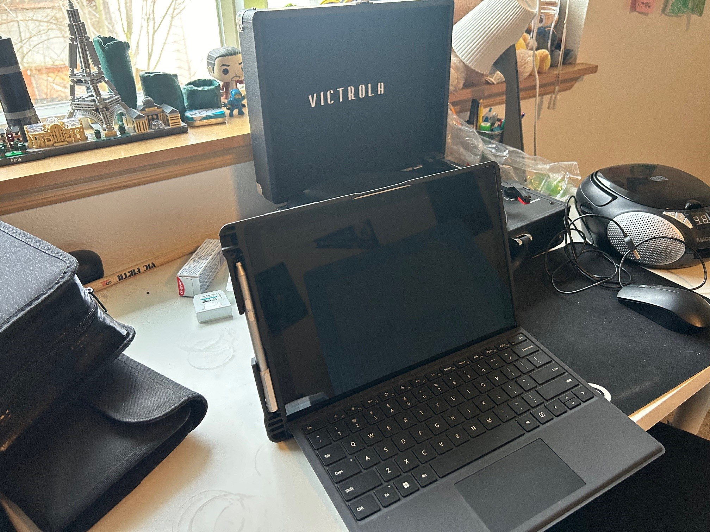
Digital Equity
Federal/State Initiatives
Digital Equity Act passed 2021
Internet for All in Washington: https://www.commerce.wa.gov/building-infrastructure/washington-statewide-broadband-act/internet-for-all-wa/
State Legislature
Digital Equity Learning Network of Seattle & King County: https://www.digitalequitykc.org/
Notes:
Federal level – digital equity act “grant programs for promoting digital equity, supporting digital inclusion activities, and building capacity for state-led efforts to increase adoption of broadband”
WA state broadband office – developing 5-year action plan and state digital equity plan – goal of expanding broadband access by seeing who can be eligible for federal funding that is now available through that digital equity act
Current state legislature session in Olympia:
HB 2327 Providing a revenue stream to fund digital equity programs.
HB 2313 Changes to the WA Digital Equity Act
DELN: collaboration of community based organizations, public and private institutions, and individuals invested in digital equity in our region
Photo: copyright Kristen Hoffman; a computer on a student’s desk

Slide 5
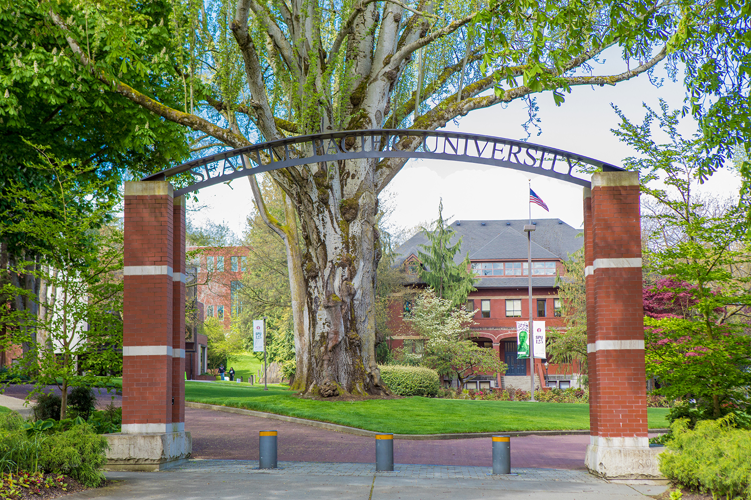
Digital Equity
Local Initiatives
CIS – Affordable Laptops: https://spu.atlassian.net/wiki/spaces/CIS/pages/36143930/Affordable+Laptop+Program+for+Students
Library – Laptop checkouts and computer lab
Notes:
At library: about 30 Chromebooks to lend (3 day cko), MacBook Pro (24; 4 hour checkout), iPad mini (2; 3 day cko)
Photo: Copyright Seattle Pacific University

Slide 6
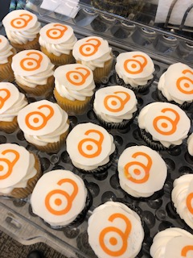
Information Equity
High cost of journal/database subscriptions
Open Access
Why – both using and contributing
How – how to find and contribute, evaluate, cite
Textbooks
Notes:
Example of journal high cost: Computers in Human Behavior – anytime students are wanting to research social media and affect on humans; Cost is nearly $6,000/year. Journal of Affective Disorders is nearly $12,000.
For users, OA simplifies access to information without needing to have to subscribe to expensive journals/databases or pay a per-article cost. For contributors, it can be a way to increase one’s download counts/citations; share with those who can’t easily access; allow others to find and build on research or partner to continue further research; practice generosity, hope, and care
How to find: OER guide
(why); why does the library have some and not others; bookstore/library collaboration
Information access as related to textbook costs: complex. Textbook costs keep rising, publishers put out new editions frequently. We’re not able to purchase all as eBooks, but try to obtain what we can for courses
Photo: Open Access Cupcakes by Kristen Hoffman is licensed CC-BY 4.0

Slide 7
Ways to Get Involved
attend Community Technology Advisory Board meetings (City of Seattle)
volunteer with orgs in digital equity (TMF grantees?)
educate yourself
get involved with DELN
look into OA textbooks
contribute to OA (scholarship)
reach out to representatives about bills/priorities for digital equity

