Slide 1
Discerning Climate Change Information and Responses

Slide 2
Work collaboratively with staff, faculty, and students to integrate sustainability.
Point of contact for sustainability and energy-related regulatory compliance.
Propose, manage, network, and communicate Seattle Pacific's sustainability initiatives within the campus, local, and higher education communities.
Assist in defining sustainability goals; track and report key sustainability indicators.
Janette Plunkett
Energy and Sustainability Manager

Slide 3
Why Sustainability at SPU?
We affirm creation to be inherently good simply because God made it. Although part of creation, humans have a special responsibility to care for it.
We affirm creation care/sustainability as an act of worship.
We affirm creation care/sustainability as a way of loving our neighbor.
We affirm creation care as a way in which humans participate in God’s reconciling work of all creation.
I work to help us align our beliefs and actions.

Slide 4
We’re in a loving, creative, and generous creator’s story
SPU wants to be a place where we can open our imaginations to God's story
as we engage the culture and change the world
Human flourishing – Fear Not, don’t despair
The flourishing of truth, justice, mercy, Hope/Embodied action, peace and reconciliation.
Future focused: Be a blessing to future generations.
Notes:
God’s overarching story encompasses our story, our families, our community, country, etc.
https://day1.org/articles/5d9b820ef71918cdf2003a77/on_scripture_why_work_to_change_the_world_matthew_212332_by_matt_skinner
With that context, we’re talking about ““Discerning Climate Change Information and Responses”

Slide 5
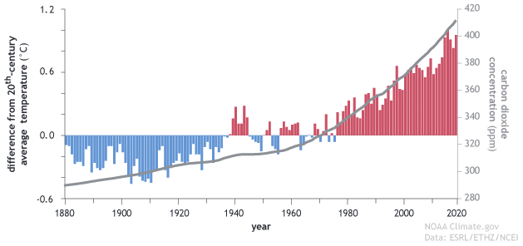
Earth’s Rapidly Increasing Fever
Notes:
2023 was hottest year on record and record billion dollar storms- https://www.noaa.gov/news/us-struck-with-historic-number-of-billion-dollar-disasters-in-2023#:~:text=The%2028%20events%20from%202023,and%20Typhoon%20Mawar%20in%20Guam).
Relate to a human body; 2 degrees Fahrenheit above average temp (98.6) and you’re starting to feel sick and you don’t want the temperature to go higher.

Slide 6
My reference As science predicted, now we’re having Extreme Droughts, Wildfires, Storms, Floods, Health issues.
Notes:
Relate my 2004 conversations with Wa State Climatologist and UW Climate Impacts group. They accurately predicted we’d feel effects starting around 2020. Should we be experimenting with our life support system? https://www.noaa.gov/news/us-struck-with-historic-number-of-billion-dollar-disasters-in-2023#:~:text=The%2028%20events%20from%202023,and%20Typhoon%20Mawar%20in%20Guam).

Slide 7
We’ve had the Goldilocks Planet
It provides our life support systems - A, W, F, S
To keep it healthy we need to transition from fossil fuels per science and “the world”/Cop28
The US is the top exporter of Fossil Fuels, a highly profitable and powerful industry
Notes:
Provides Air, Water, Food, Shelter. s See BIO llogos info for all the factors that make our planet habitable

Slide 8
Why haven’t we done more?
Lack of social cohesion nurtured by disinformation?
Political will –global effort – Unenforced Paris Agreement
Perceived as future problem – we’re not wired for that
Magnitude of change – adapt, mitigate and transition
Economics – we need to build a new economy that threatens the business model of highly profitable industries
Notes:
https://theconversation.com/it-is-not-just-heat-waves-climate-change-is-also-a-crisis-of-disconnection-210594

Slide 9
History of Disinformation
The tobacco industry and fossil fuel industry employed the same scientists to challenge the scientific consensus (see “Merchants of Doubt” and LA Times series):
The dangers of smoking, Long Series of Regulations and pricing
The effects of acid rain, 1990 Clean Air Act
The existence of the "ozone hole“, 1987 Montreal Protocol
The existence of climate change, 2015 Paris Agreement
Used by Heartland Institute, Cato Institute and a web of Koch brothers funded organizations
Promote a libertarian ideology that views government regulation as a step towards socialism and originally communism.
Lawsuits with reams of fossil fuel company documents show they also funded a web of global warming deniers while they used global warming science in their business decisions. The Claim- they lied to protect their profitability.
Notes:
They’ve been wrong on all these issues!!! Not providing solutions just sowing doubt. https://en.wikipedia.org/wiki/Merchants_of_Doubt https://www.latimes.com/business/story/2023-09-20/california-oil-companies-lawsuit-global-warming https://theconversation.com/more-than-two-dozen-cities-and-states-are-suing-big-oil-over-climate-change-they-just-got-a-boost-from-the-us-supreme-court-205009 “Merchants of Doubt” per Harvard historians and LA TIMES https://www.sourcewatch.org/index.php/Heartland_Institute https://www.greenpeace.org/usa/fighting-climate-chaos/climate-deniers/front-groups/

Slide 10
How do They Spread Disinformation?
Cite fake experts
Cherry-pick data
Impugn the integrity of individual scientists
Impugn the scientific process
Place impossible demands on the science
Appeal to conspiracy theories.
Goal: Leaving the public with the perpetual impression that there are lots of unresolved questions and that scientists are not to be trusted.

Slide 11
Social Media impacts?
Are social media platforms changing the way we communicate, build and maintain relationships, set social standards, and negotiate and assert our society’s values?
In the process, have they become spaces that make it profitable (via ad revenue) to spread disinformation about Climate Change?
Notes:
Porterfield, Carlie (2 November 2021). "Breitbart Leads Climate Change Misinformation On Facebook, Study Says". Forbes. Retrieved 3 November 2021.

Slide 12
Who‘s spreading Disinformation?
The 10 “Fringe Publishers”
Breitbart
Western Journal
Newsmax
Townhall Media
the Media Research Center
the Washington Times
the Federalist Papers
the Daily Wire
Russia Today
the Patriot Post.
Forbes and the Financial Times cite a Center for Countering Digital Hate (CCDH) report that identified “ten fringe publishers” with 186 million followers
responsible for majority of Facebook user interactions with content that denied climate change.
And Fox News reports from same/similar sources
Transcript analysis of their climate change reporting revealed it promoted doubt and skepticism ( >80% in 2019, continuing trend).
Notes:
CCDH says 70% , I used majority because Facebook raised some questions about that but didn’t provide an alternative number. https://www.mediamatters.org/climate-deniers/three-concerning-trends-shaped-right-wing-media-climate-change-narratives-2023 https://vitalsigns.edf.org/story/fox-drops-tucker-carlson-fake-news-lives

Slide 13
99.9 percent of peer-reviewed science studies agree on climate change but
In a survey of 2,396 US participants
59% of Fox viewers believe that scientists disagree
35% of non Fox viewers
56% of Fox viewers think renewable energy is too expensive
34% percent of non Fox viewers
60% of Fox viewers think renewables are unreliable,
32% of non Fox viewers
Notes:
https://insideclimatenews.org/news/15112022/climate-disinformation-campaigns-threaten-cop27-progress-a-new-report-concludes/, https://climate.nasa.gov/faq/17/do-scientists-agree-on-climate-change/#:~:text=Yes%2C%20the%20vast%20majority%20of,global%20warming%20and%20climate%20change.

Slide 14
12,000 YouTube Videos by Organizations Promote Climate Denial
Notes:
CCDH cited in Forbes and https://www.ft.com/content/aa369295-1805-414c-af99-3c7596df0847?utm_source=substack&utm_medium=email

Slide 15
Is It Working?
Teens in the UK
Notes:
https://counterhate.com/wp-content/uploads/2024/01/CCDH-The-New-Climate-Denial_FINAL.pdf and https://skepticalscience.com/ccdh-the-new-climate-denial.html?utm-source=email&utm-campaign=daily
Grist - How YouTube’s climate deniers turned into climate doomers

Slide 16
This week’s example of attacks on solutions– Electric Cars
News items raising concerns that Electric vehicles don’t work in the cold, stalled all over Chicago, etc. !!
bounty of data from Norway (per capita, earth’s leading EV nation)
“electric vehicles fail at a lower rate than gas cars in extreme cold”
Their equivalent of AAA—electric cars are almost twice as good as fossil cars in the cold.
Notes:
https://electrek.co/2024/01/17/electric-vehicles-fail-lower-rate-than-gas-cars-extreme-cold/?utm_source=substack&utm_medium=email There is a learning curve and adjustments that one makes with EV’s.

Slide 17
Enablers
Per online platforms response to concerns about revenue share and therefore, reward and amplify clear climate denial content
Facebook’s Climate Science Information Center pledged to attach labels to posts about climate change and to expand fact-checking in a move to combat misinformation
But 92% of the climate change misinformation reviewed by the CCDH was not labeled by Facebook and 99% had no additional context or fact-checking attached.
Google- “prohibit ads for, and monetization of, content that contradicts well-established scientific consensus around the existence and causes of climate change.”
Climate Action Against Disinformation (CAAD) coalition easily found violations (>18 million views) from well known disinformation sources that had top brand advertisers
Notes:
https://www.theverge.com/2023/5/2/23707993/google-youtube-ads-climate-change-disinformation Same CCDH study as previously cited.

Slide 18
My strategy for news intake
Pull from limited, trusted print sources who cite references, aggregate news and balance progress and challenges
Guardian – global nonprofit with climate competent journalists
Seattle Times- local news
Bill McKibben newsletter – climate journalist
Katherine Hayhoe newsletter – Climate Scientist-PBS Global Weirding, Ted Talk
Push- I respond to things friends and family forward, talk about it and seek to build relationships. With skeptics- connect on what we care about that could be impacted by Climate Change
Focus on prevention and action and spread the news of collaborators
E.g., Hot Issue of LNG expansion issue – Third Act, local Sierra Club

Slide 19
The parable of the flowers; anger, lament/ prayer, re-imagine
Notes:
My story of hearing the ftd flowers had a HUGE carbon footprint and treated workers poorly but I loved getting flowers at the office. Angry that I might have to “give it up” a frequent fear of change. I vented/lamented/prayed but didn’t stop there. Imagined a better alternative- local, Pike Market flowers from a refugee community ☺ I believe God will help us find alternatives as we create a better world.

Slide 20
How can you respond when you get content that implies?
Science is unreliable.
Advocates for action on science are unreliable.
Solutions won’t work.
Impacts aren’t that bad or far in the future.
Notes:
What’s the source ? Has it been fact-checked, reviewed? Is it transparent about methods and data?

Slide 21
Responses
What’s the source ?
Do they have a history of bias?
Do they have vested interests?
Has it been fact-checked, reviewed?
Are they transparent about methods and data?
Is data from peer reviewed sources NASA, NOAA, UN, Universities.

Slide 22
Good News
The sun, wind, and geothermal provide incredible amounts of energy that power the natural world, we need to invent that kind of economy.
Human immune system- thousand of groups, cities, states, countries using Science to advance progress.
Drawdown- > 100 existing solutions
Clean energy –90% of new energy installed around the world was clean energy (IEA, 2021).

Slide 23
You are fighting climate change by living in Seattle
Seattle’s per-person emissions have gone down 20% since 2008 due to our policies and culture 😊.
Seattle's Building Emissions Performance Standards (BEPS) seeks to reduce building emissions by 27%
The New Washington State Building Code Council finalized its landmark state building code which almost entirely rules out fossil fuels in new construction.
SPU’s District Energy presents opportunities to decarbonize on a large scale.

Slide 24
More Good News
Good Tipping points. Forty percent of the world’s shipping sends fossil fuels around the world to be burned, so using less… potential double win.
Amazing entrepreneurs –carbon-negative flooring products. ☺
Holistic successes in other less-resourced countries – Finland, Costa Rica.

Slide 25
Join our loving, creative and generous creator
AT SPU we offer
Minors that can be applied to all majors —
Ecotheology — Integrates a foundation of faith and science.
Sustainability Management — Study sustainability issues with business, government, and civil society.
Specialized Majors/minors/tracks
Data Analytics — Used in all fields to measure and track progress.
Ecology
Engineering
International Sustainability Development Major
UN PRME Champion Business School, multiple majors
Social Justice including track for Environmental Justice
Sustainability Club – Thursdays at 3:30, Library 3-A
Come be involved in Earth Day !
Notes:
https://day1.org/articles/5d9b820ef71918cdf2003a77/on_scripture_why_work_to_change_the_world_matthew_212332_by_matt_skinner

Slide 26
Questions?

Slide 27
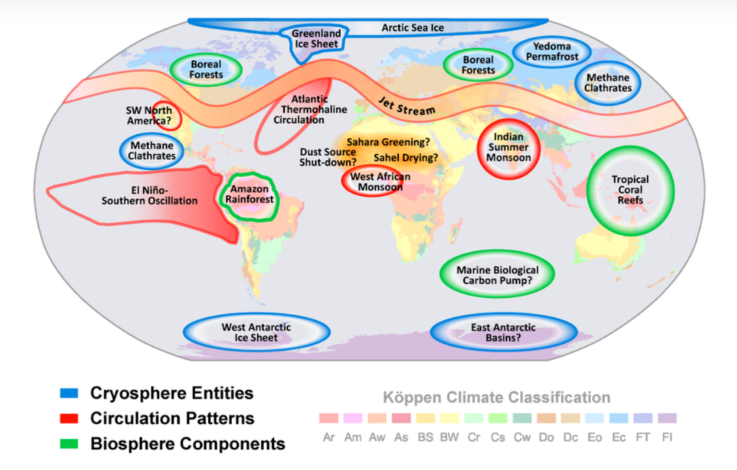
Urgency due to triggers of unforeseeable impacts
Concern is tipping points that unleash systemic change that disrupts our coping ability and cause breakdown in eco, social, economic and political systems:
Notes:
All these affect water/biodiversity.
Heavily populated areas are at risk.
https://www.forbes.com/sites/davidrvetter/2021/06/03/just-2-degrees-of-warming-could-trigger-climate-domino-effects-new-study-reveals/?sh=8ffd2746
E918
Sea Level rise; we’re locked in for awhile-
https://news.mit.edu/2017/short-lived-greenhouse-gases-cause-centuries-sea-level-rise-0109
And this doesn’t cover “local issues” like shellfish - https://www.king5.com/article/tech/science/environment/ocean-acidification-washington-shellfish-industry/281-9f8f822d-f4b2-47be-8ce9-c69fb267459a
and Alaskan snow crabs, enormous crash-https://www.adn.com/alaska-news/2022/04/10/into-the-ice-snow-crab-decline-hits-bering-sea-island-community-of-st-paul/
https://www.pik-potsdam.de/en/output/infodesk/tipping-elements
More details on tipping points - https://www.carbonbrief.org/explainer-nine-tipping-points-that-could-be-triggered-by-climate-change
To counter Climate Scientist Mark Maslin
“Humans are an ultra-social species,” he tells me. “The only reason we have become the dominant species on Earth is because of our incredible level of co-operation.”
“The next stage, which is rapidly evolving, is our need to support and protect our whole species and our beautiful home planet,” he says. “What gives me hope is engaging with the younger generation, who already think as a global species as they realise how small and precious our world really is.”

Slide 28
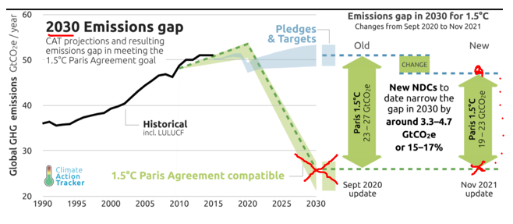
How were we doing 2021 Fever reduction efforts; 2021 COP agreements
Notes:
Keep things at 99 degrees, our current state
50% from a 2005 baseline (how many entities will have a 2005 baseline?) because the data indicate we need to halve carbon emissions by the end of this decade to prevent global warming from causing far more devastating climate swings. By 2050 we need to reach net-zero emissions , releasing no more carbon than we can pull back out of Earth’s atmosphere.
From - https://climateactiontracker.org/media/images/CAT_2021-11_Briefing_2030EmissionsGaps-Changes2.original.png
https://www.wri.org/insights/5-reasons-us-should-cut-its-ghg-emissions-half-2030

Slide 29
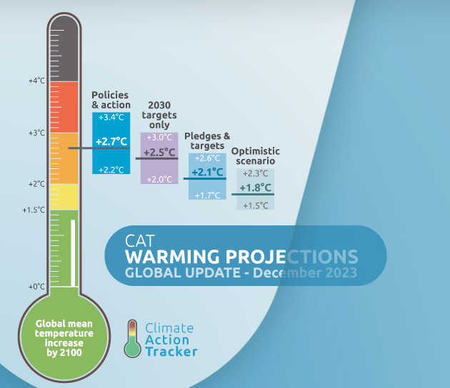
COP28 – December 2024
Notes:
Keep things at 99 degrees, our current state
50% from a 2005 baseline (how many entities will have a 2005 baseline?) because the data indicate we need to halve carbon emissions by the end of this decade to prevent global warming from causing far more devastating climate swings. By 2050 we need to reach net-zero emissions , releasing no more carbon than we can pull back out of Earth’s atmosphere.
From - https://climateactiontracker.org/media/images/CAT_2021-11_Briefing_2030EmissionsGaps-Changes2.original.png
https://www.wri.org/insights/5-reasons-us-should-cut-its-ghg-emissions-half-2030

Slide 30
The challenge is fulfilling 2030 Actions
Notes:
https://climateactiontracker.org/press/release-state-of-climate-action-report-finds-progress-lags-on-every-measure-except-ev-sales/

Slide 31
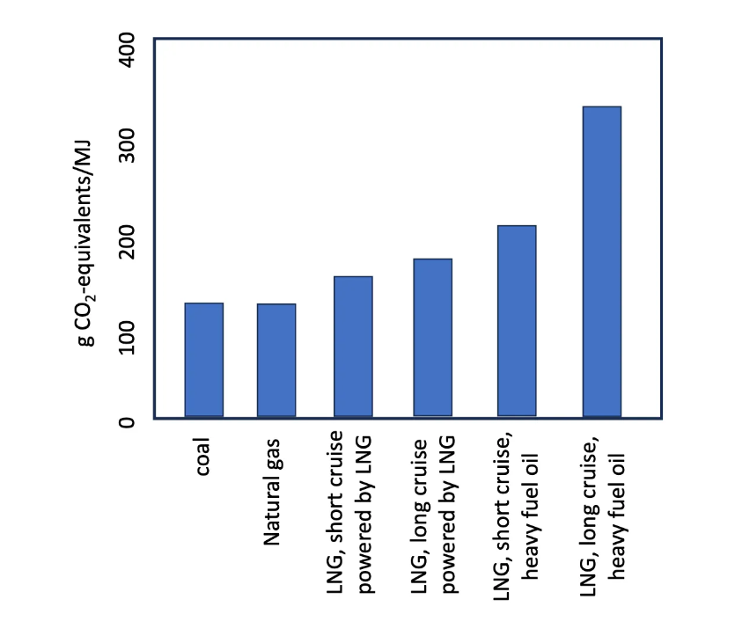
What’s the Red Hot issue?
Which country is the top exporter of Fossil Fuels?
Which country is proposing the largest expansion of Liquid Natural Gas, LNG for export?
If fully built –estimated to emit 3.2 billion tons of greenhouse-gas emissions annually, close to the entire annual emissions of the European Union.
Would exported LNG replace dirtier fuels?
No, per a study currently in peer review …………………>>
Would it help Ukraine/EU? Debatable?
Notes:
Store the David Woodson email on this.

Slide 32
Who’s concerned and what are they doing?
Hundreds climate scientists, including several from the UW
60 Democratic lawmakers, included SPU’s House representative, asked for “updated climate and economic analyses.”
Activists (Third Act) are planning mid February nonviolent civil disobedience in DC

Slide 33
What you can do at SPU:
Talk about mutual interests affected by Global Warming. Believe that it doesn’t have to be this way. Create Hope by taking action.
Join the Sustainability Club in Engage –Thursdays, 3:30 in the library (3-A)
Attend The Faith, Diversity and Science lectures. Katharine Hayhoe this Spring!!
By living in Seattle and Attending SPU you are helping the immune system!
We’ve influenced the City of Seattle and Washington State building energy policy to enable some amazing decarbonization projects at universities.
Align job market sustainability skills with SPU disciplines as part of Microsoft and LinkedIn’s new Initiative for Sustainability Education.
Take classes – you’re doing it!

Slide 34
L: Every part of the earth is sacred.
Every shining pine needle, every sandy shore, every mist in the dark woods, every clearing and humming insect is holy.
L: The rocky crest, the meadow, the beasts and all the people, all belong to the same family. Teach your children that the earth is our relation.
Whatever befalls the earth befalls the children of the earth. We are part of the earth, and the earth is a part of us.
L: The rivers are our brothers; they quench our thirst.
The perfumed flowers are our sisters, the air is precious, for all of us share the same breath.
L: The wind that gave our grandparents breath also receives their last sigh.
The wind gave our children the spirit of life.
L: This we know, the earth does not belong to us.
We belong to the earth. Whatever we do to the web we do to ourselves.
Let us give thanks for the web and the circle that connects us. Thanks be to God, the God of all.
[[adapted from United Methodist Book of Worship, inspired by oration of Chief Seattle…https://www.resourceumc.org/-/media/umc-media/2021/02/05/15/21/2021_nams_liturgy.ashx?la=en]]

Slide 35
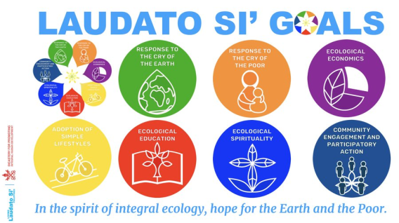
Faith initiatives
Laudatosi.org
Faith for Earth Initiative, United Nations Environmental Program. https://www.unep.org/about-un-environment/faith-earth-initiative
The National Religious Partnership for the Environment
www.nrpe.org
https://creationcare.org/who-we-are/beliefs.html

