Slide 1
Healthy Coping Mechanisms Within Recovery Setting
Ylliam, Izzi, Hallie, Ingrid, Hannah & Hanin

Slide 2
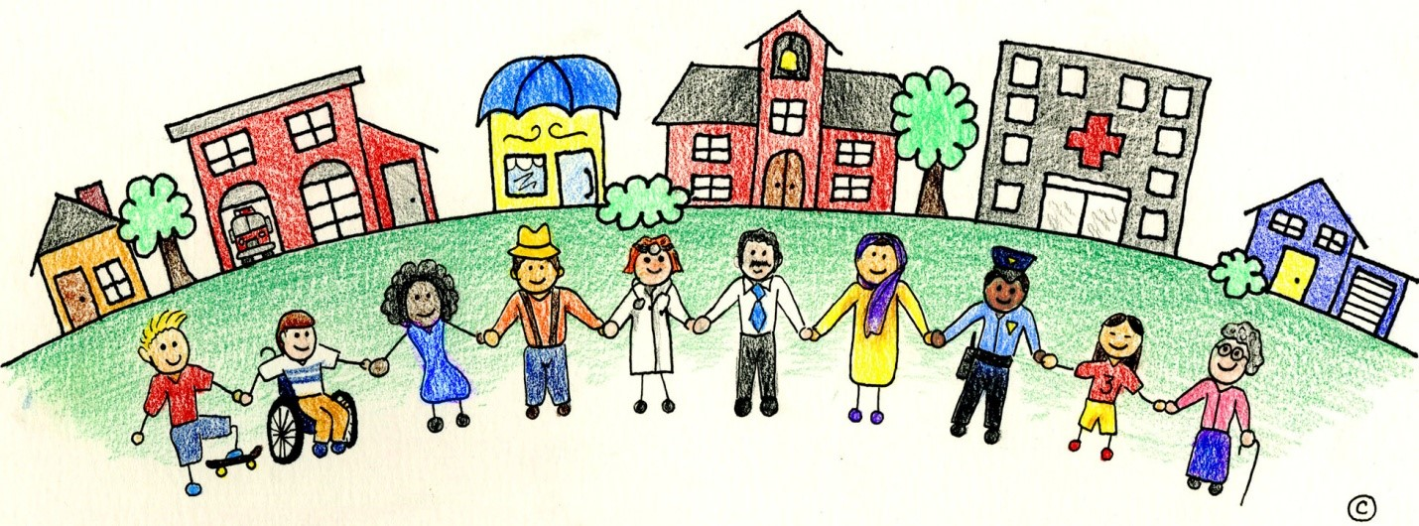
Population
Unhoused
Post-trauma
Addictive behaviors/ recovering
Mental health
https://www.shutterstock.com/search/cartoon-community
https://medicine.ouhsc.edu/academic-departments/psychiatry-and-behavioral-sciences/terrorism-and-disaster-center/cart-community-resilience-toolkit

Slide 3
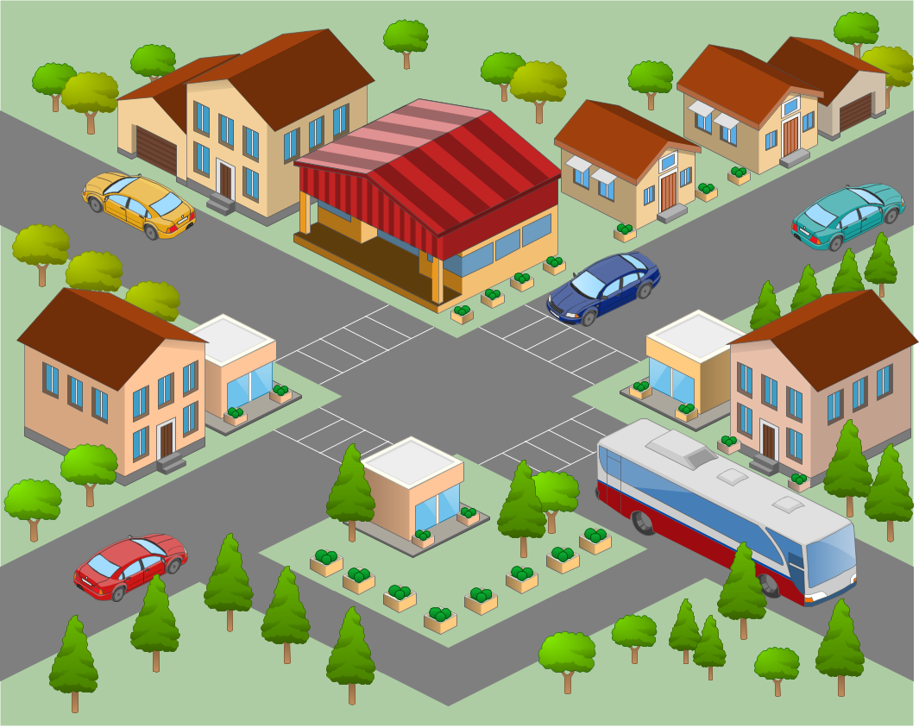
Assessment/Planning
Windshield survey
Verbal surveys of clients
Liaison
Gantt chart
Weekly report
Established relationships and trust in previous visits and then began interventions
https://www.pinterest.com/pin/301107925078283113/
https://www.cleanpng.com/png-service-business-organization-logistics-consultant-843759/

Slide 4
Nursing Diagnosis
Ineffective coping
r/t the instability of recovery
secondary to stress
aeb client statements of loss of control, drug use, high blood pressure & client statements of feeling stuck or lonely
https://www.walmart.com/ip/Standard-Stay-Well-Stay-Safe-Sign-Black-Gold-Small/2314930299

Slide 5
Project Goal
Clients: identify personal implementation of one healthy coping mechanism by the end of our interventional education session
https://www.insightsintoimpact.com/6-tips-for-setting-meaningful-goals/

Slide 6
Interventions (Coping mechanisms)
Journaling
Improves wellbeing in psychological, relational, & physical aspects of life
Reduces mental distress, anxiety, & perceived stress
Helps manage mental distress, especially concerning anxiety
Can be done in 15 minutes a few times a week for results
Art therapy
Reduces stress & anxiety
Improves cognitive functions
Box breathing
Improves mood
Reduces stress
Clears & calms the mind
Controls breathing, decreases blood pressure & heart rate
https://ocrelationshipcenter.com/blog/signs-symptoms-stress/
https://personalbalancecounseling.com/2019/06/09/using-your-body-as-an-ally-to-work-with-stress/

Slide 7
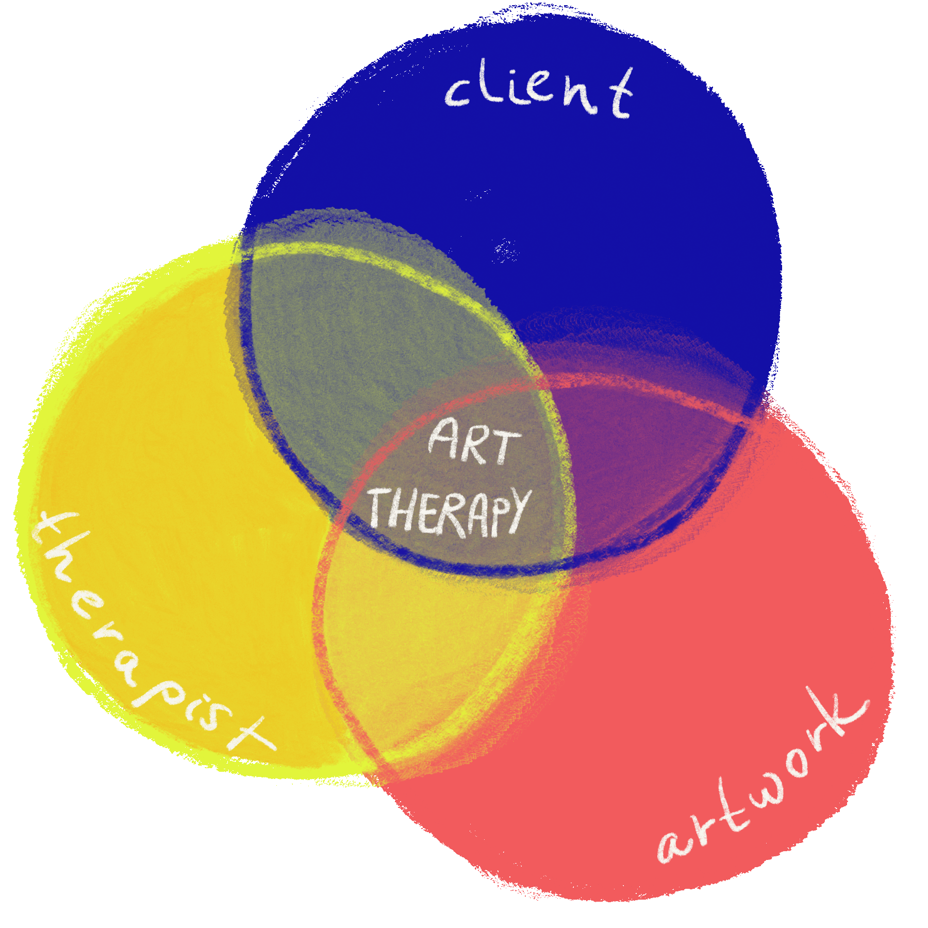
Outcomes
Pre-intervention survey
17 clients
64.7% do not currently have healthy coping mechanism
Art & Journaling therapy
47% found beneficial
Box-breathing
6 clients
83% reduction in BP
Post intervention data -Will the interventions be used?
15 clients - 40% new implementation
https://giphy.com/stickers/art-therapy-arttherapy-RfMlSAsZtCkXvxWRHb

Slide 8
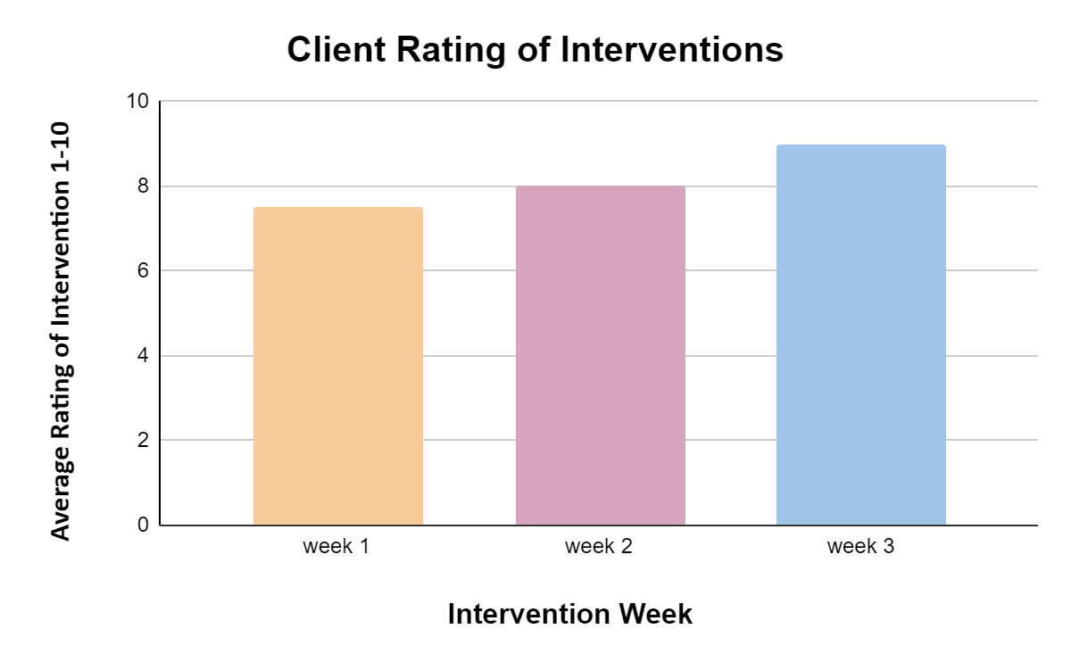
Post-Intervention Outcomes
How effective were the interventions?

Slide 9
Limitations
Bias from only interested clients
Data about intervention efficacy included repeat clients and new clients
No long-term reevaluation
https://pngtree.com/freepng/traffic-sign-with-black-border-on-red-triangle-and-exclamation-mark_5489819.html

Slide 10
Recommendations
Establish rapport early on
Include an art bin at the site for continued coping
Create weekly journaling activity time

Slide 11
Questions?

