Slide 1
open data open scholarship open educational resources
ETM Workshop
series:
Week
Autumn 2022
Photo Credit: openaccessweek.org

Slide 2
What is the 2022 Open Access Week Theme?
Open for Climate Justice
“Climate Justice is an explicit acknowledgement that the climate crisis has far-reaching effects, and the impacts are “not be[ing] borne equally or fairly, between rich and poor, women and men, and older and younger generations,” as the UN notes. These power imbalances also affect communities’ abilities to produce, disseminate, and use knowledge around the climate crisis. Openness can create pathways to more equitable knowledge sharing and serve as a means to address the inequities that shape the impacts of climate change and our response to them.”

Slide 3
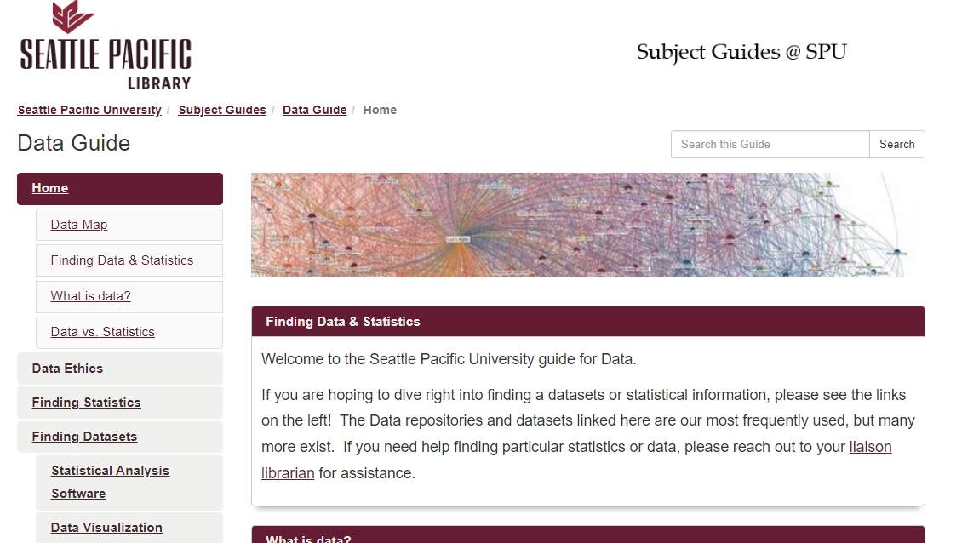
How do I find out more? SPU Library Data Guide: https://spu.libguides.com/data

Slide 4
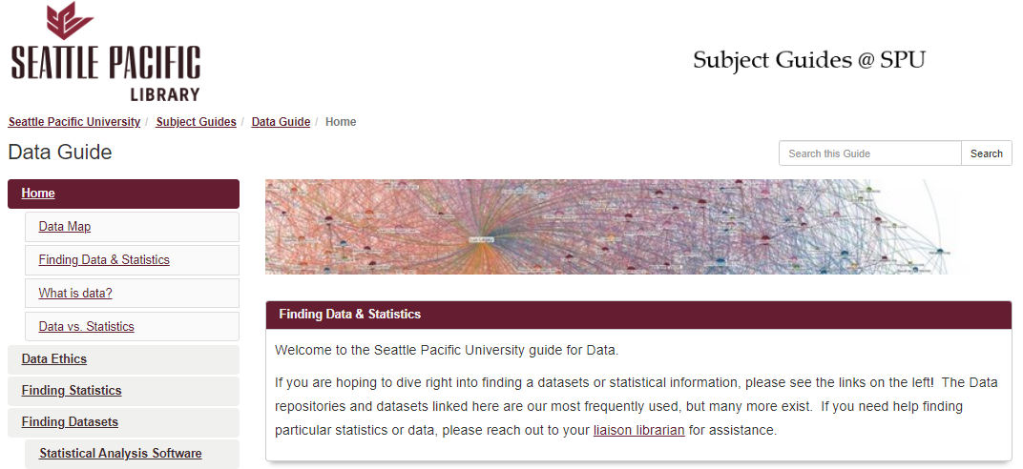
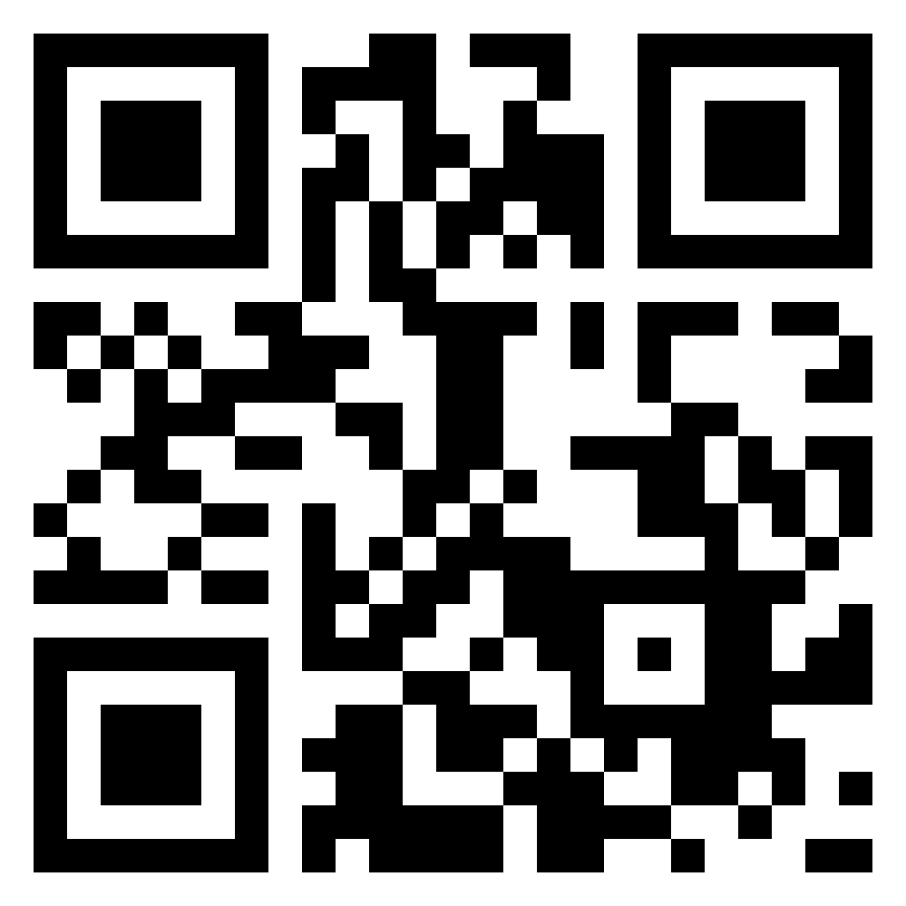
Where can I find open data?
Selected Open Data Repositories:
Dryad Digital Repository
Zenodo
Harvard Dataverse
Google Dataset Search
Need a one-stop shop
to find Open Data?
Check the SPU library Data Guide!

Slide 5
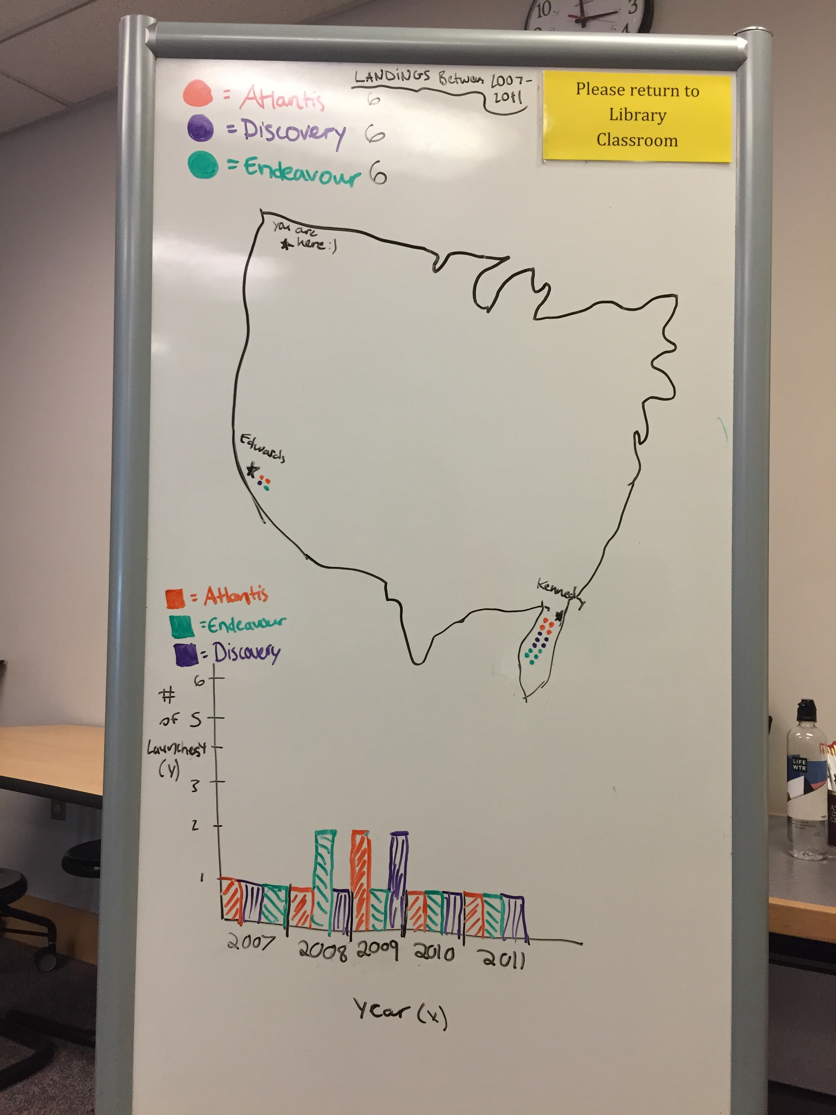
Want to start using data sets in class? Simple Data Set Assignment: Create a visualization
Using a table from Wikipedia: https://en.wikipedia.org/wiki/List_of_Space_Shuttle_missions
NASA Space Shuttle Launches and Orbital Flights
Order | Launch date | Shuttle | Crew^{[a]} | Duration | Landing site
1 | 12 April 1981 12:00:04 UTC 07:00:04 EST | Columbia | 2 | 02d 06h | Edwards
2 | 12 November 1981 15:10:00 UTC 10:10:00 EST | Columbia | 2 | 02d 06h | Edwards
3 | 22 March 1982 16:00:00 UTC 11:00:00 EST | Columbia | 2 | 08d 00h | White Sands
4 | 27 June 1982 15:00:00 UTC 11:00:00 EDT | Columbia | 2 | 07d 01h | Edwards
5 | 11 November 1982 12:19:00 UTC 07:19:00 EST | Columbia | 4 | 05d 02h | Edwards
6 | 4 April 1983 18:30:00 UTC 13:30:00 EST | Challenger | 4 | 05d 00h | Edwards
7 | 18 June 1983 11:33:00 UTC 07:33:00 EDT | Challenger | 5 | 06d 02h | Edwards
8 | 30 August 1983 06:32:00 UTC 02:32:00 EDT | Challenger | 5 | 06d 01h | Edwards
9 | 28 November 1983 16:00:00 UTC 11:00:00 EST | Columbia | 6 | 10d 07h | Edwards
10 | 3 February 1984 13:00:00 UTC 08:00:00 EST | Challenger | 5 | 07d 23h | Kennedy
11 | 6 April 1984 13:58:00 UTC 08:58:00 EST | Challenger | 5 | 06d 23h | Edwards
12 | 30 August 1984 12:41:50 UTC 08:41:50 EDT | Discovery | 6 | 06d 00h | Edwards

Slide 6
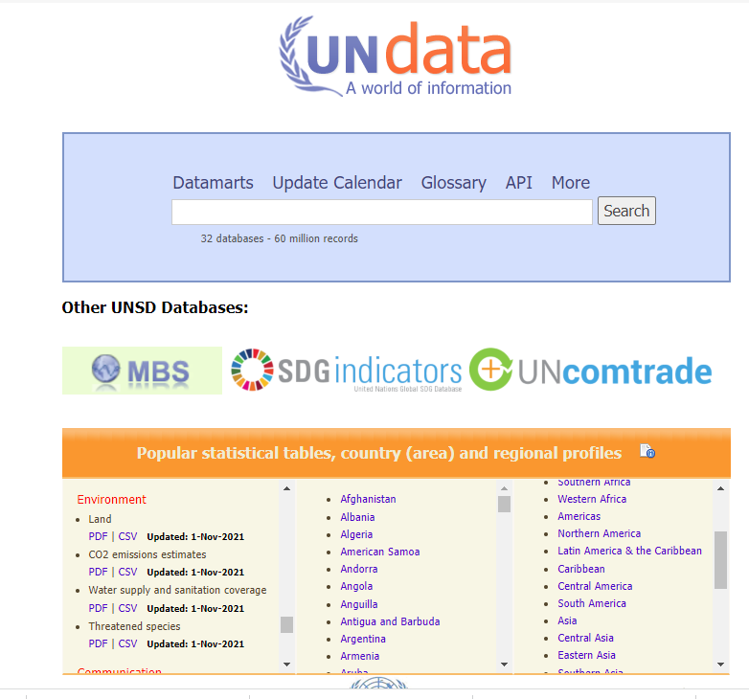
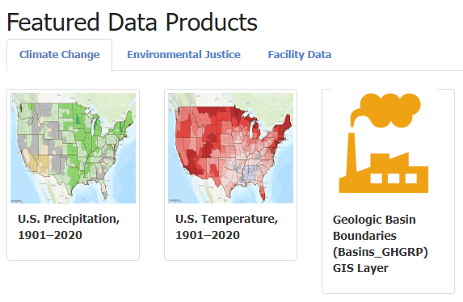
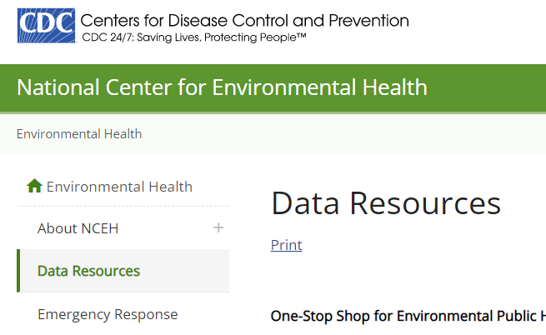
How do I find a dataset? Open Access Climate Justice Data Sets
EPA Environmental Dataset Gateway: https://edg.epa.gov/metadata/catalog/main/home.page
National Center for Environmental Health: https://www.cdc.gov/nceh/data.htm
United Nations Data: http://data.un.org/

Slide 7
How do I find a dataset? Journal Articles with associated Data Sets
*May need to email authors for access to data set

Slide 8
Which library databases can I use to search for data?
Data Planet searches open and fee-based data sources offers exports of raw data
Statista searches open and fee-based data sources and offers data visualizations

Slide 9
Where can I see how these databases work?
Watch Janet’s demonstration today or contact her for one-on-one
Choose Data Planet or Statista from SPU Library website and try it!

Slide 10
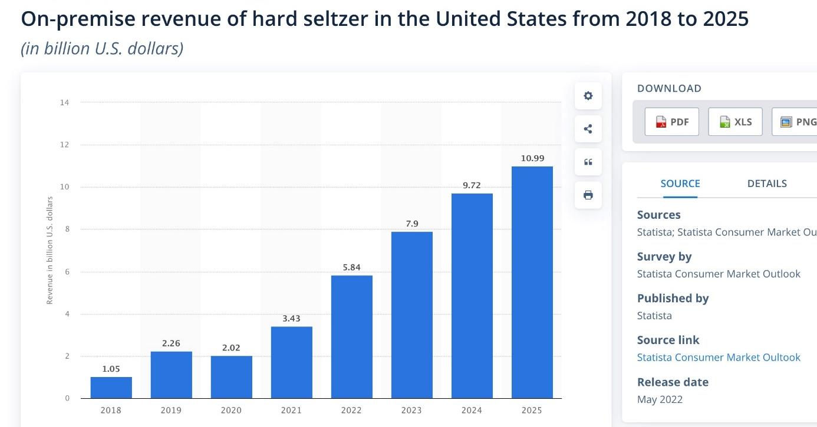
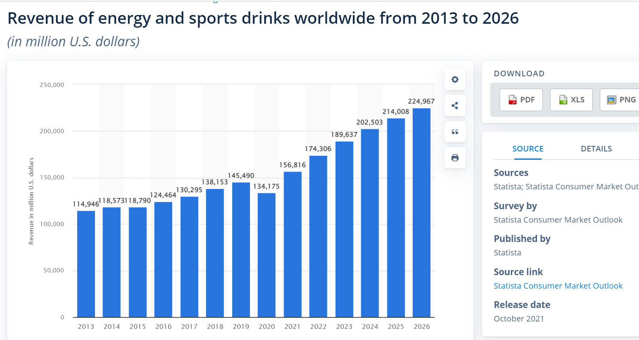
What assignments will ask students to find data? BUS 3620 Management Information Systems: find data to use while learning visualization software
“Statista has provided a great macro view of the current economic status of energy drinks. It has been a great starting spot to ask more questions and dive deeper into research.”
“My team searched Statista for data on the hard seltzer industry. The data going all the way up to 2025 is helpful in showing a forecast of the growth of hard seltzers and be used to persuade people that hard seltzers are on the rise.”

Slide 11
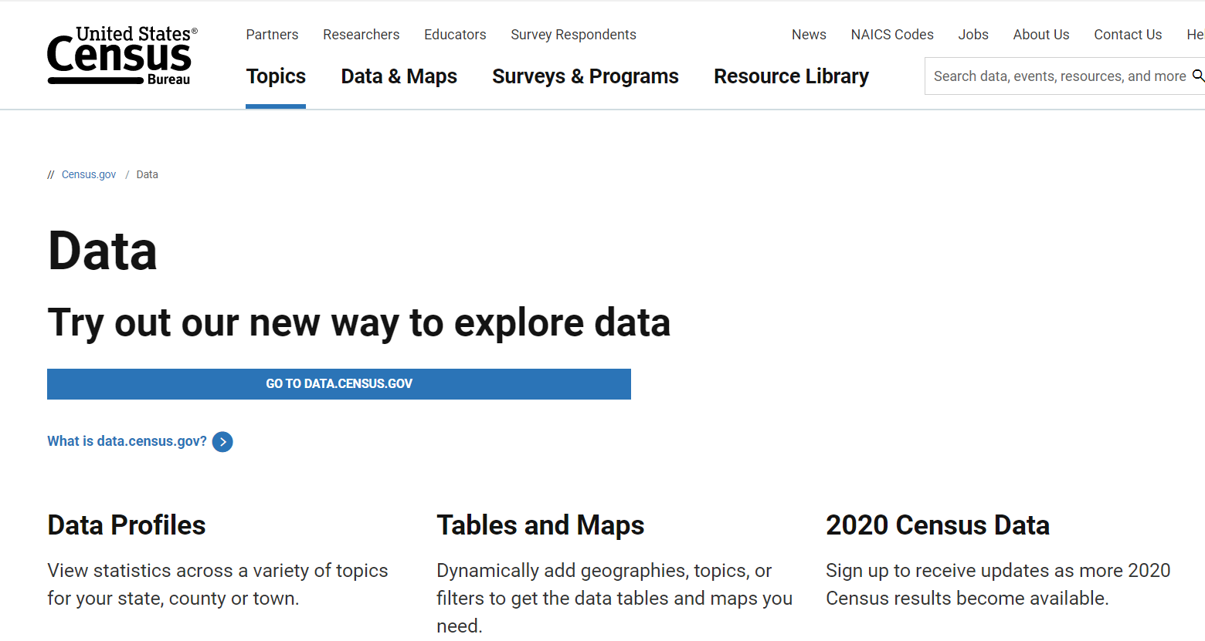
What assignments will ask students to find data? BUS 1700: Find a robust data set to use while learning Excel
“I searched the United States Census Bureau data. I am using three weeks from the Household Pulse Survey for my spreadsheets project.”

Slide 12
How can I find specific data about climate justice?
Search “climate change” in Data Planet and choose from 12 results
Search “climate change” in Statista and find survey and other data

Slide 13
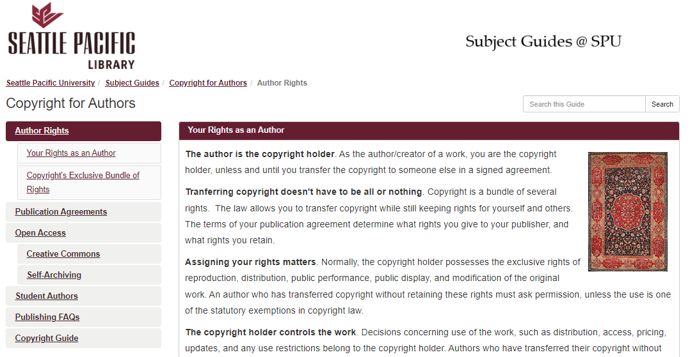
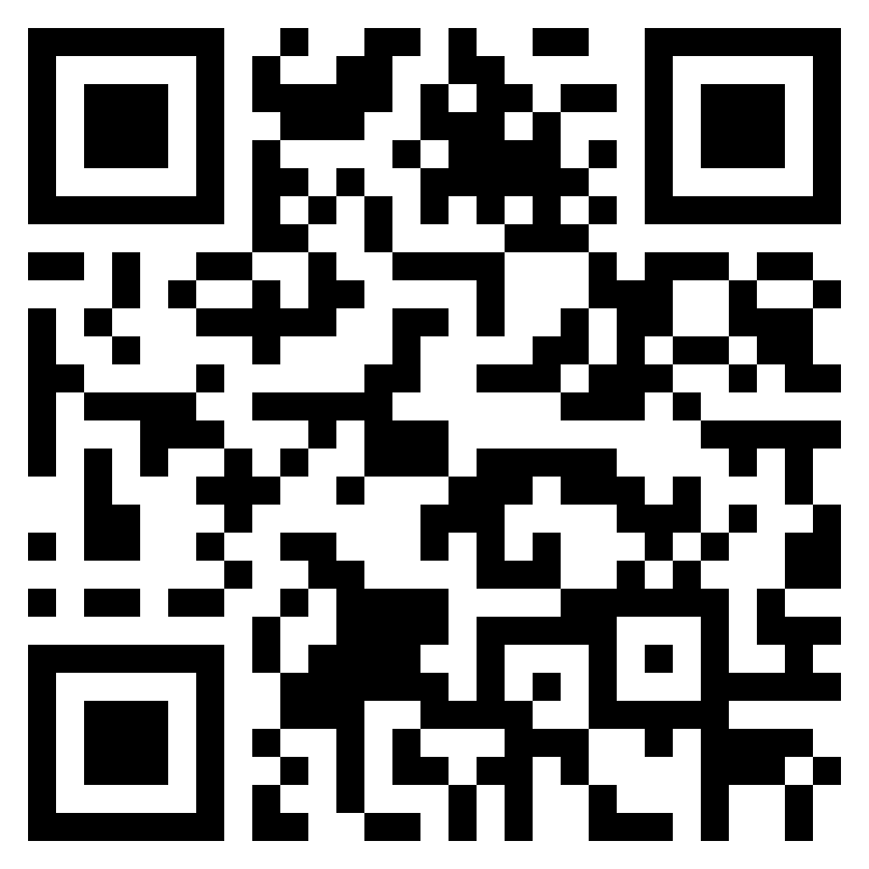
Where can I find open scholarship?
Selected Open Scholarship Repositories:
Digital Commons
DOAJ (Directory of Open Access Journals)
OSF Preprints
Need a one-stop shop
to learn about Open Scholarship?
Check the Copyright for Authors Guide!

Slide 14
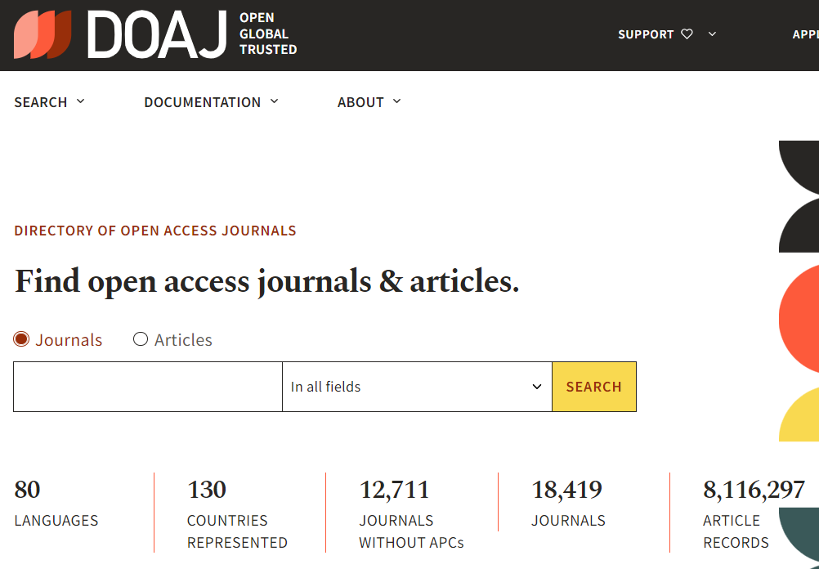
How can I contribute to open scholarship?
Publish via an open access route:
DOAJ (Directory of Open Access Journals)
Traditional Journal publishers
Drawbacks
May require fee (e.g., article processing charge [APCs], open access fee)
Benefits
Well-known, established publishers and publication process
Discoverability; Higher citation counts

Slide 15
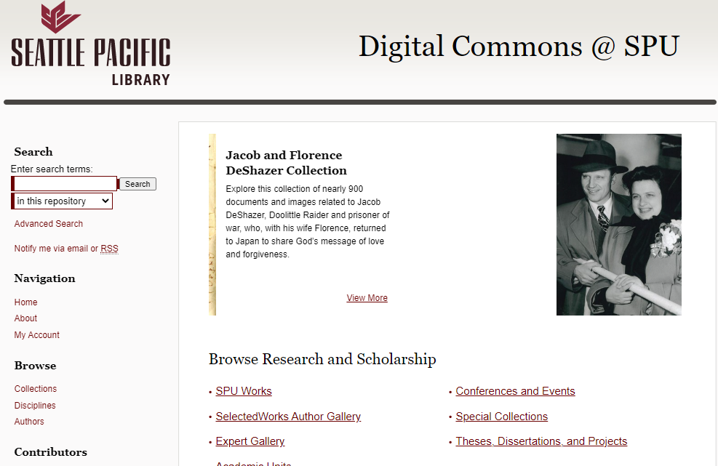
How can I contribute to open scholarship?
Self-archive your already published work
Digital Commons @ SPU
Subject-based Repository (e.g., PubMed Central, SSRN, arXiv, OSF Preprints)
Personal website or online profile

Slide 16
How can I contribute to open scholarship?
Explore open scholarship practices:
Registered Reports (two-stage peer review)
Scholar IDs (e.g., ORCID, Google Scholar ID)

Slide 17
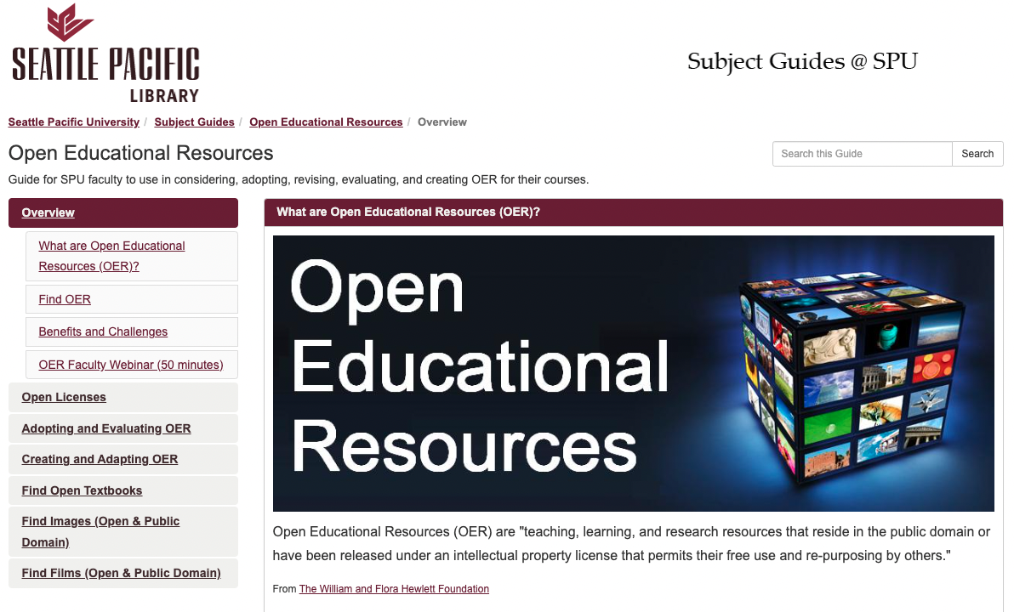
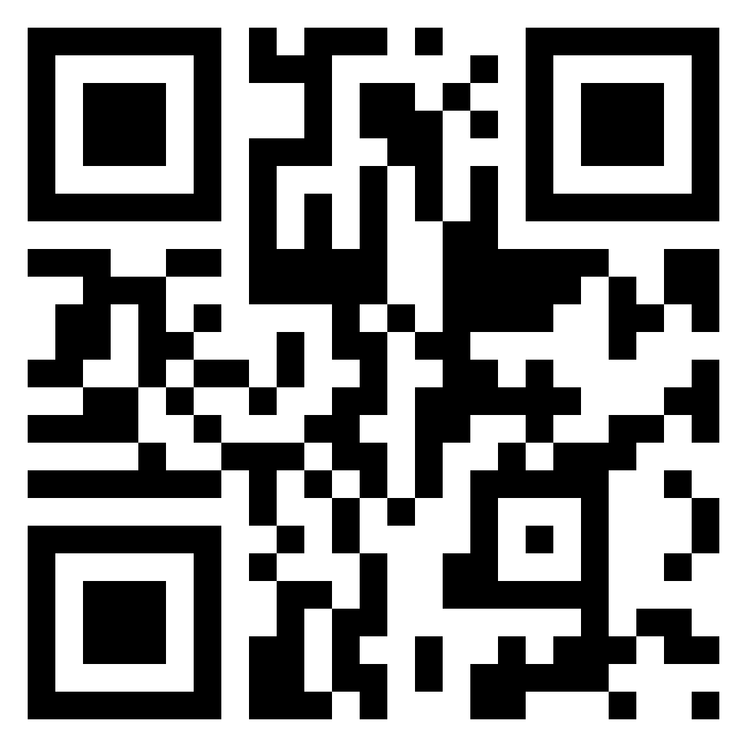
Where can I find OER?
Selected OER Repositories:
Open Textbook Library
OER Commons
OER in Canvas Commons
Need a one-stop shop
to find OER?
Check the SPU library OER Guide!

Slide 18
How can I use OER with my class?
Adopt an Open Textbook to replace an expensive textbook to save costs for students
Adapt existing OER to fit the learning outcomes of your particular course
Create an Open Textbook for your students

Slide 19
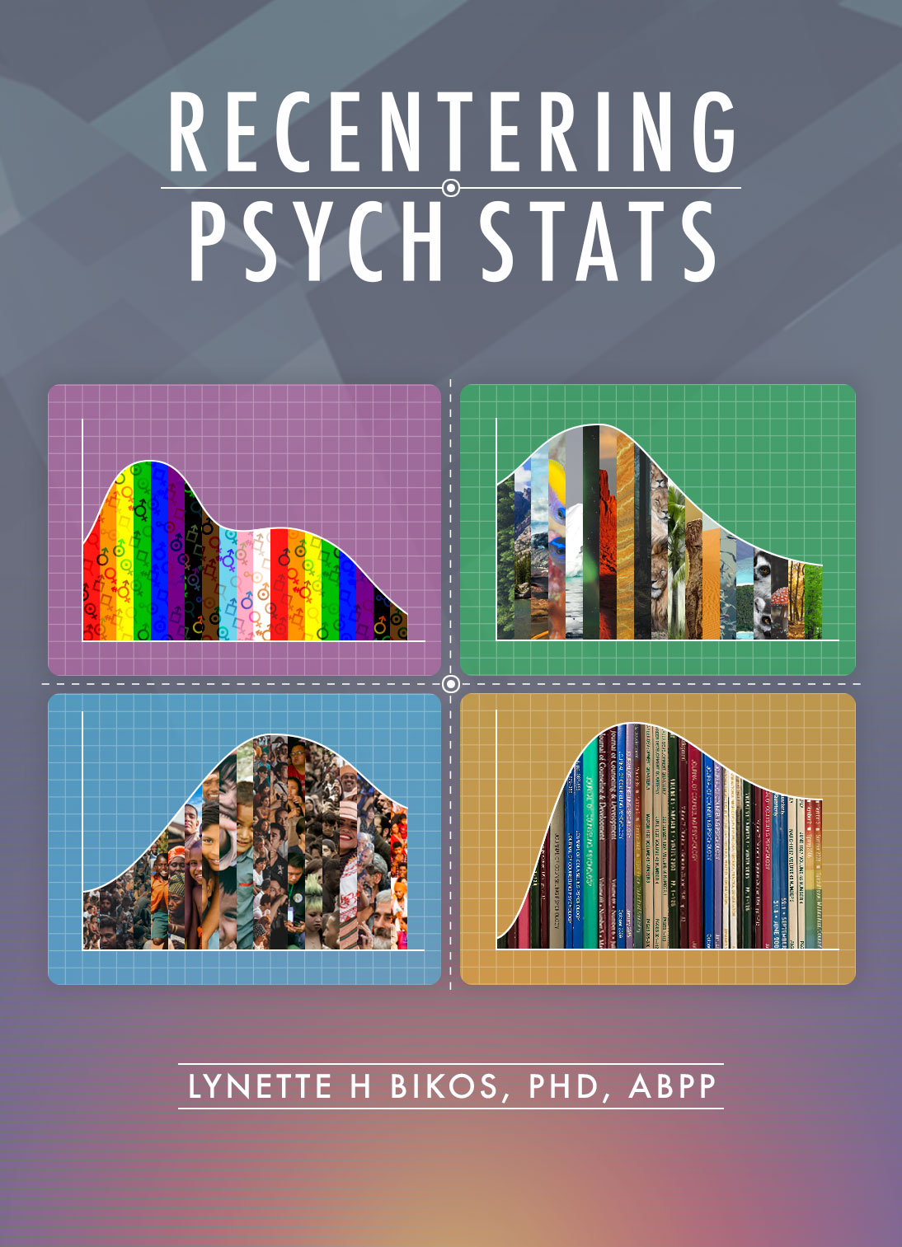
How can I use OER with my class?
Use OER to design your course for flexibility and relevancy to meet students' needs
Customize your course to respond to the individuals needs of learners within a changing learning environment (e.g., Resilient Pedagogy)
Use OER to increase the timeliness and/or relevance of the material (e.g., Authentic Learning)

Slide 20
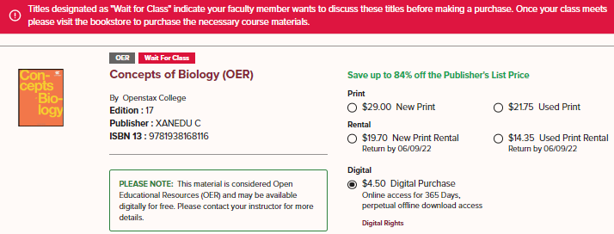
How can I use OER with my class?
When adopting an open textbook, let the SPU Bookstore know
The bookstore likes to carry 1 to 2 copies for students who may need a (low-cost) physical book. The information the student sees on the website is pictured:

